Slide 1
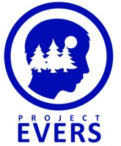
EVERS Personal Wellness
SEL: Responsible
Decision-Making
Presenter, title, organization
www.projectevers.org
Notes:
The Benefits of Responsible Decision-Making
"The time is always right to do what is right." - Martin Luther King Jr.
As children and young adults grow, they face challenges that require them to make increasingly complex decisions. For young children, this might involve deciding to share a toy. For a senior in high school or a young adult, this could be recognizing negative peer pressure and incorporating that knowledge into their decision making.
Learning to consider the positive and negative consequences of a decision is essential at any of these stages. The Collaborative for Academic, Social, and Emotional Learning – usually and hereafter referred to as CASEL - identifies responsible decision-making as one of the five pillars of social emotional learning. By developing responsible decision-making skills early on, students can be prepared to face real-world challenges that will impact the course of their lives. With those skills in place, young people are equipped to:
develop and evaluate ethical standards that build character
use decision-making skills that incorporate positive social norms as an influence in navigating the difficulties of adolescence and resisting peer pressure and peer influence, and
evaluate potential consequences of actions to determine what choice is best for them

Slide 2
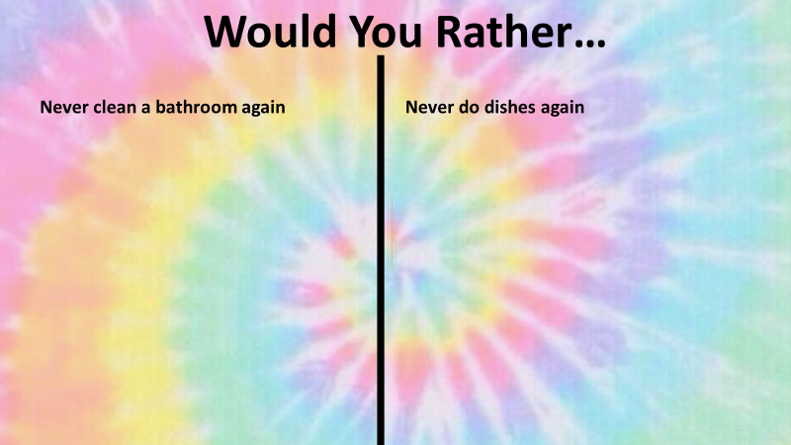
Social Emotional Learning
Icebreaker: Would You Rather?
www.projectevers.org
Notes:
You may be familiar with the fun, somewhat addicting, game where you have to choose between two sometimes funny / sometimes difficult scenarios. Either way it’s a great conversation starter!
Activity Steps:
Model a couple of “Would You Rather?” questions as a whole group.
Split into small groups or breakout rooms and discuss some more.
Debrief with the whole group what they learned.

Slide 3
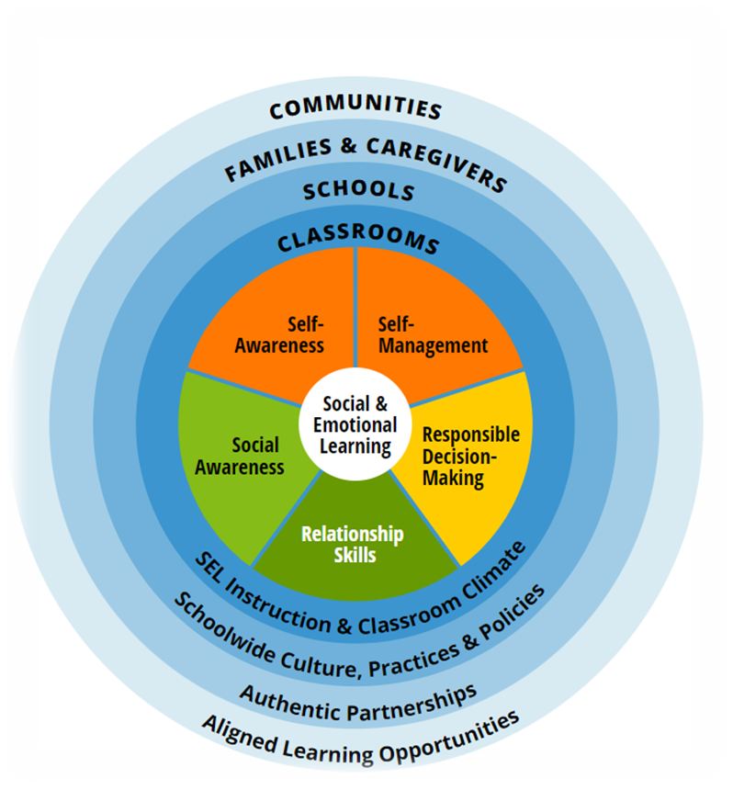
Social Emotional Learning
CASEL Model
Notes:
CASEL is one of the most trusted sources for knowledge about high-quality, evidence-based social and emotional learning. They are basically the gold standard when it comes to all things SEL.
Educators, families, students, community organizations, and researchers around the world use the “CASEL Wheel” to describe what SEL looks like in practice. The five broad, interrelated areas of competence found in the middle of the wheel are: self-awareness, self-management, social awareness, relationship skills, and responsible decision-making.

Slide 4
What is SEL?
Social Emotional Learning
An integral part of education and human development
The process through which all young people and adults acquire and apply the knowledge, skills, and attitudes to develop healthy identities, manage emotions, achieve personal and collective goals, feel and show empathy for others, establish and maintain supportive relationships, and make responsible and caring decisions
www.projectevers.org
Notes:
While educators instinctively know that social and emotional learning is an important foundation of student success, schools have historically focused on teaching academic content. However, we are collectively waking up to the notion that being able to manage one’s mind is as important as filling it with information. If this pandemic has taught us anything, it is seeing the value in being able to manage our emotions, cope with stress, and empathize with others.
“Either we spend time meeting children’s emotional needs by filling their cup with love, or we spend time dealing with the behavior caused from their unmet needs. Either way we spend the time.”—Pam Leo, Connection Parenting
What Is Social and Emotional Learning (SEL)?
CASEL defines SEL as “the process through which children and adults understand and manage emotions, set and achieve positive goals, feel and show empathy for others, establish and maintain positive relationships, and make responsible decisions.” Sounds pretty good, right? And it also sounds very necessary!
CASEL identifies SEL’s five core competencies as self-awareness, self-management, social awareness, relationship skills, and responsible decision-making.

Slide 5
Why SEL?
Social Emotional Learning
SEL can help all young people and adults thrive personally and academically, develop and maintain positive relationships, become lifelong learners, and contribute to a more caring, just world.
SEL advances educational equity and excellence through authentic school-family-community partnerships to establish learning environments and experiences that feature trusting and collaborative relationships, rigorous and meaningful curriculum and instruction, and ongoing evaluation.
SEL can help address forms of inequity and empower young people and adults to co-create thriving schools and contribute to safe, healthy, and just communities
www.projectevers.org
Notes:
As 21st century learners, our students need to be able to think creatively, work collaboratively, and be innovative. These skills require taking risks, making mistakes, and working well with others, which all require a substantial amount of SEL.
Interrelated among the core competencies is the all-important work of equity. Educational equity means that all
students have access to the same resources and educational rigor despite race, gender, ethnicity, language, disability, family background, or family income (Jagers, Rivas-Drake, Borowski). SEL can be an important tool for advancing educational equity as it can help schools promote understanding, examine biases, reflect on and address the impact of racism, build cross-cultural relationships, and cultivate adult and student practices that close opportunity gaps and create a more inclusive school community.

Slide 6
Video: Understanding Trauma for Educators
Social Emotional Learning
Notes:
As we continue to learn more about trauma – either past traumas or on-going events – we know that trauma affects the way we learn. Let’s review how we all best learn!
https://www.youtube.com/watch?v=KoqaUANGvpA&list=PL1IxMju2nKYTLHattdbs8A8VsqwufaWra&index=5&t=165s
As humans, our brains aren’t fully developed until around age 25. Those of us over 25 rely on the prefrontal cortex (the “rational” part of the brain) to make sound, responsible decisions. However, research shows children, teens, and young adults use the amygdala—the “emotional” or “reactionary” part of the brain—to make decisions. Because the connection between the prefrontal cortex and the amygdala is still a work in progress for young people, our students often base their judgments on their emotions rather than considering long-term consequences (The Connecting Link; Stanford Children’s Health).
There is good news here: we can help students strengthen the connection between the prefrontal cortex and the amygdala by supporting a student to examine the possible outcomes based on their chosen course of action. Oftentimes children (or even grown adults) act on emotion and bypass evaluating the benefits and consequences of their actions. Leading students through the decision-making process with intention helps build their capacity to make good choices for themselves and others. In doing so, we also support the student to respond (pause, evaluate consequences, and make a constructive decision that considers all parties involved) rather than react in the moment.
Our brains are built to react before we respond. Think about the number of adages that caution us against acting before we have all the information needed to make a good decision:
Measure twice, cut once.
Look before you leap!
“A moment of patience in a moment of anger saves you a hundred moments of regret.”—Miguel Ruiz

Slide 7
Social Emotional Learning
Learning Brain
Survival Brain
Open to new information
Comfortable with ambiguity
Sees big picture
Calm, peaceful, excited to learn
Playful, curious
Not afraid to make mistakes (part of learning)
Hyper-focused on threat
Does not like ambiguity
Thinks in black and white
Does not like making mistakes
Feels doubt, panic, fear
Afraid of looking stupid
www.projectevers.org
Notes:
This slide is a recap of what we just heard in the video. For the most part, our job is to help young people stay in (or get to) their learning brain, so they are open to new information, new perspectives, and they are ready to learn.
There are several ways we can support students in learning responsible decision-making skills. We’ll review and use some of those decision-making frameworks and tools a bit later. These tools can be found in the Personal Wellness Module 9 Responsible Decision-Making on Project EVERS’ website.

Slide 8
Social Emotional Learning
www.projectevers.org
Notes:
There is a great deal of compatibility and connection between trauma sensitive schools or classrooms and social emotional learning. Awareness of the impacts of trauma and building skills and environments that support resilience are foundational to both.
The SEL competencies are critical skills we all need now. Today, everyone must be able to:
analyze the consequences of our individual and collective actions on not only our own, but on others’ health and safety
make decisions that promote well-being
engage in collective action when needed

Slide 9
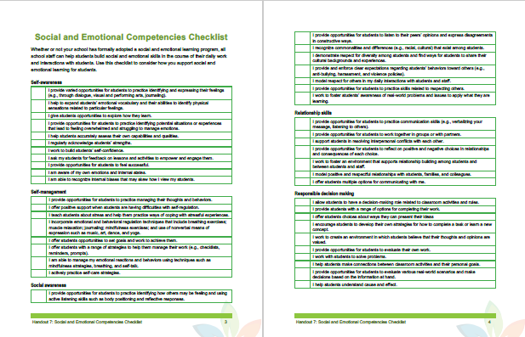
Activity: Social and Emotional Competencies Checklist for Staff
Social Emotional Learning
Source: Trauma Sensitive Schools Training Package
Notes:
Whether you use a formal SEL program in your area or not, this checklist is a great resource to review each of the five CASEL social and emotional competencies. It offers ideas and suggestions that you can implement in your own day-to-day work that will support social and emotional learning for students.
NOTE: if time permits:
Provide the handout to the participants
Divide the participants into groups to focus on the responsible decision-making. How can we best promote this competency in our students?
What additional tools do you need to promote each competency?
Discuss as a whole group.

Slide 10
SEL Competencies
Social Emotional Learning
www.projectevers.org
Notes:
Let’s look at the core competencies of SEL. They are:
Self-Awareness
Self-Management
Social Awareness
Relationship Skills
Responsible Decision-Making

Slide 11
Self-Awareness Competency
The ability to:
Accurately recognize emotions, thoughts, and values
Assess strengths and limitations
Focus on confidence, optimism, and a “growth mindset”
Skills we need now:
Identify and process pandemic and racial injustices
Process complex emotions when things are uncertain/socially turbulent
Reflect on our strengths
Understand our cultural, racial and social identities
Examine our implicit biases
www.projectevers.org
Notes:
Competency: SELF-AWARENESS is the ability to accurately recognize one’s own emotions, thoughts, and values and how they influence behavior. It also is the foundation for being able to accurately assess one’s strengths and limitations with a well-grounded sense of confidence, optimism, and a “growth mindset.”
Skills We Need Now As we process the aftermath of the pandemic, the nation’s racial injustices, and political divisions, self-awareness is critical to identifying and processing our complex emotions when things are uncertain and socially turbulent. Self-awareness helps us identify and reflect on our strengths; understand our cultural, racial, and social identities; and examine our implicit biases.
SEL prioritizes responding over reacting. Now that’s a superpower in my book! By labeling emotions that we feel, we can create distance between ourselves and our experience. That distance allows us to choose how we respond to challenges.
Having a Growth Mindset
In a fixed mindset, people believe their basic qualities, like their intelligence or talent, are simply fixed traits. Whereas in a growth mindset, people believe that their most basic abilities can be developed through dedication and hard work. If you have a growth mindset, it “creates a love of learning and a resilience that is essential for great accomplishment.”
Becoming more self-aware helps us to manage our thoughts, emotions, and behaviors, rather than allowing them to manage us. The more self-aware we are, the better able we are to feel hurt without spreading hurt. Having a growth mindset and learning from our mistakes enables us to get one step closer to achieving our goals. Understanding our cultural, racial, and social identities helps us to understand ourselves and the impact we have on the world around us. Intentionally working to become more self-aware helps us to show up in the classroom (and the world) as the best versions of ourselves.
Additional benefits include:
Better relationships
Better decision making
More effective communication
Increased productivity
Improved classroom performance (especially those with learning and attention issues)
Greater preparation for a variety of careers in the “real world”

Slide 12
Self-Management Competency
The ability to:
Manage one’s emotions, thoughts and behaviors effectively in different situation
Manage stress, control impulses and motivate oneself
Achieve goals and aspirations
Skills we need now:
Cope with grief and loss
Develop resiliency
Express our beliefs / resist injustices
Practice anti-racism
www.projectevers.org
Notes:
Chronic and high levels of stress can be downright toxic to our minds and bodies. The physical and biological effects of stress (dilated pupils, increased heartbeat, etc.) render us far less receptive to learning. We also know that our students who belong to marginalized and historically underserved populations experience more stress more frequently—specifically, the toxic stress of racism, which we know contributes to adverse mental and physical health effects in people of color (Comas-Diaz & Hall, 2019; Williams, 1999). While there are many different causes of stress, we’re most successful in managing our stress when we can identify the source.
It’s important to note that CASEL identifies practicing anti-racism as a self-management skill. As this school year gets underway, school districts and educators all across the country are engaging in the all important work of anti-racist professional development. An anti-racist educator actively works to dismantle the structures, policies, institutions, and systems that create barriers and perpetuate race-based inequities for people of color (Simmons, 2019).
As mentioned earlier, our students experience a substantial amount of stress related to racism. Racism yields racial inequities and disparities in every sector of private and public life. That includes in politics, health care, criminal justice, education, income, employment, and home ownership.
Everyone needs skills to address these very real issues.

Slide 13
Social Awareness
The ability to:
Understand perspectives of and empathize with others including those from diverse backgrounds, cultures, and contexts
Be aware of and tolerant of diversity/ respect differences
Skills we need now:
Empathy
Perspective-taking
Respect for others
Diversity awareness
www.projectevers.org
Notes:
Relationship skills and social awareness go hand-in-hand. Social awareness is the ability to take the perspective of and empathize with others, as well as learning social and ethical behavior. Developing social awareness requires high emotional intelligence, which, just like math or science, has a place in school curriculum.
Social awareness also involves becoming aware of and tolerant towards diverse backgrounds. This appreciation can come from recognizing similarities but also respecting possible differences.
The benefits of social awareness speak for themselves. Research shows that highly empathetic people generally have less stress than unempathetic people. Social awareness also improves cooperation, particularly in tense situations, which strengthens both classroom climates and a student’s capacity for other SEL competencies.
Social awareness subskills include:
Empathy
Perspective-taking
Respect for others
Diversity awareness

Slide 14
Relationship Skills
The ability to:
Establish and maintain healthy, supportive relationships
Effectively communicate and navigate settings with diverse individuals
Seek or offer help when needed
Skills we need now:
Verbal and non-verbal communication
Teamwork
Social engagement
Relationship building
www.projectevers.org
Notes:
People are biologically wired to need close, rewarding relationships. Learning to establish and maintain these relationships is essential for not only success but lifelong fulfillment. Relationship skills teach students how to get along and make meaningful connections with people in their life. Skills could include the ability to communicate, listen, validate emotions, resist social pressures, and use conflict resolution methods, among other social skills.
Another crucial component of this competency is learning to seek or offer help when needed. By knowing when a loved one is struggling and reaching out, students can put their relationship skills to practice. Plus, students can strengthen their relationships and support system by asking for help when challenges arise in their own lives.
People who have close relationships in life experience significantly less stress than those who feel isolated. They also have better health overall and are less likely to develop physical or mental illnesses. And, best of all, those with strong relationship skills report feeling a greater sense of purpose in life.
Every component needed to be a healthy, happy human being is affected by the connections we share with other people – which is why teaching your students relationship skills is one of the most meaningful things you can do for them!
Relationship subskills include:
Verbal and non-verbal communication
Teamwork
Social engagement
Relationship building

Slide 15
Responsible Decision-Making
The ability to:
make caring and constructive choices about personal behavior and social interactions
Skills we need now:
www.projectevers.org
Notes:
Responsible Decision-Making includes the capacities to consider ethical standards and safety concerns, and to evaluate the benefits and consequences of various actions for personal, social and collective well being.
Essentially, all aspects of a potential decision and its consequences must be considered before a choice is made. To make the most appropriate behavioral choices, students need to learn how to evaluate the situation, analyze their options, and consider the potential consequences of each of those options for themselves and others.

Slide 16
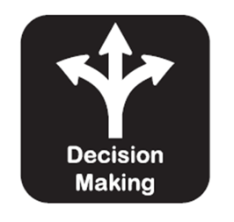
Decision-Making 5-Step Process
Responsible Decision-Making
www.projectevers.org
Notes:
What Skills are Associated with Responsible Decision Making?
Step 1: Identify the problem or the decision that needs to be made: Students must be able to accurately recognize when they have encountered a problem. Problems can range from difficulty meeting the expectations in a classroom, to choosing whether or not to complete homework, or even deciding to engage in unhealthy behavior, such as lying or using banned substances. It is important that students can appropriately acknowledge when they are faced with a problem. For some, recognizing that they are in a difficult situation can be challenging as a result of their language-based difficulties or social communication weaknesses.
Step 2: Analyze the situation and brainstorm options. Once students have succeeded in identifying the problem, they must then learn to analyze the situation from a variety of angles, which includes identifying how and why the problem arose. To build this skill, students may benefit from your guidance to fully understand their role in the developing situation.
Step 3 - Identify Possible Outcomes. After students have sufficiently identified, analyzed, and considered the problem, they then need to develop and practice methods for solving problems. They need to identify possible options and explore the potential consequences of each option. Educators can play a significant role in guiding the practice and implementation of these methods. A variety of frameworks and tools for developing options and potential outcomes are included in the Activities Section of this module.
Step 4 - Make a decision or solve the problem: As decisions are being finalized, this is a great (and timely) opportunity to help students consider ethics, responsibility and any natural or identified consequences of a final decision. For instance, before a student chooses to look at someone else’s test, the student needs to consider the potential ethical and moral repercussions of cheating.
Step 5 - Evaluate and reflect: Evaluating and reflecting on what happened is almost as important as the decision-making process itself. When students take the time to evaluate how successfully they identified, analyzed, and solved a problem, they are more apt to engage in appropriate reflection on what went well and what could be improved. This reflection allows students to note any necessary changes and work to incorporate those in their next decision-making opportunity.
Obviously, much of the work – and many of the skills sets - are interdependent on each of the five CASEL Competencies… I think it puts perspective on the ability, skills and knowledge needed for young people to make responsible decisions.

Slide 17
Support Responsible Decision-Making
ENCOURAGE student to use their knowledge about themselves to:
Maintain a growth mindset and demonstrate curiosity and open-mindedness
Learn to make reasoned judgements after analyzing information, data, and facts
Identify solutions for personal and social problems that are right for them
Anticipate and evaluate the consequences of one’s actions
Recognize how critical thinking skills are useful both inside and outside of school
www.projectevers.org
Notes:
One of the greatest gifts you can give your students is encouragement and support. You’ll never be able to make decisions for them, but you can certainly help them build a set of skills that will enable them to be their own best advocate, while also helping them develop their own goals. Teaching the skillsets identified here will help each student have confidence in their abilities to reach those goals.

Slide 18
Responsible Decision-Making
Allow students to have a decision-making role
Provide students with a range of options for completing their work and activities
Offer students choices about ways they can present their ideas
Encourage students to develop their own strategies for how to complete a task or learn a new concept
Work to create an environment where student believes that their thoughts and opinions are valued
Provide opportunities for students to evaluate their own work
Work with students to solve problems
Help students make connections between academic activities and their personal goals
Provide opportunities for students to evaluate various real-world scenarios and make decisions based on the information at hand
Help students understand cause and effect
www.projectevers.org
Notes:
How do we teach and support skills?
There is no hierarchy in SEL; the competencies are all closely linked and interrelated when looking at responsible decision-making. For example, to do the right thing by standing up to friends who are mistreating others, students need to be in touch with their own values (self-awareness) and be able to regulate conflicting emotions (self-management); they also need to be able to empathize with those affected (social awareness) and resist peer pressure to join in (relationship skills)
Responsible decision-making is a lifelong skill that can create incredible outcomes in our lives. And, decision-making is something we all end up having plenty of practice with (whether we like it or not) so, we say, let’s get good at it.
The benefits of developing responsible decision-making system are many… Pick a few activities from the examples on the slide that you could implement tomorrow!

Slide 19
Responsible Decision-Making
Activity: Video and Handout - What are my Values?
Notes:
https://www.decisioneducation.org/decision-focus-values
Most decisions are not necessarily right or wrong, but we can weigh them based on our values. So what does Value-Based Decision-Making looks like. Watch the video and complete the activity
Steps:
Watch the video – Decision Focus 4 – Clear Values #decisonmaking (Decision Education Foundation)
Complete the Clear Values Activity in the handout below
Discuss: What have you learned? How would you do this with your students?

Slide 20
Climate of Resilience
Responsible Decision-Making
Fulfillment
Goal: Help students develop resilience so they can build the capacity to handle difficult circumstances and manage the impact of stress and trauma in their lives!
Autonomy
Achievement
Security
Connection
Notes:
Let’s consider a common goal that we may have in working with our students. This is a difficult time for many immigrant youth and families, so our ultimate goal right now could look something like: ensuring that our students develop skills and resilience to handle the many difficult circumstances they face.
The responsibilities of our structures and systems are to create steps that support that goal.
The foundation is always Connection – a caring adult relationships that demonstrate values, understanding and support.
Security – Belonging: creating a secure, accepting environment “I belong here” ”I fit” “I am missed if I’m not here”
Achievement – Recognizing and fostering success from a strengths-based perspective
Autonomy – Giving guidance and offering options in academics, discipline and self-management
Fulfillment – Looking at others. Having an Awareness Orientation. Seeing needs of other people and saying “I can meet them”
Our goal is to help students be prepared to handle difficult situations. This skill will help them for the rest of their life.
We will go through each tier in more detail.

Slide 21
Building a Climate of Resilience: Connection
Responsible Decision-Making
Connection
Notes:
Connection is a basic human need. If we don’t have a genuine connection, no interventions will work.
Let’s be honest… Connection:
Does not come naturally for all adults.
It’s not about you and your story.
Demands authenticity. Without sincere care and concern, the connection will not be fruitful.
Requires patience and consistency. Time moves slowly and sometimes youth sabotage the connection to test it or escape from something with which they are uncomfortable.
Useful tools for making connections:
Interest – Notice – have curiosity about each students’ interest and passions without judgement
Familiarity – Become familiar with the student interests, tendencies and demeanors.
Show value – Look for the strengths of students and seek to show relevance or value of the characteristic or skill set
Ask questions – Be curious. Generic questions can be planned but connected to follow-up questions. Seek information and insights into who the student is and what is important to them
Common Ground – Seek to find common ground and learn from them.

Slide 22
Responsible Decision-Making
Activity: Video - How a Coach Saved My Life
Notes:
Let’s hear it From one that could say it best – The Rock!

Slide 23
Building a Climate of Resilience: Security
Responsible Decision-Making
Security
Connection
Notes:
Dwayne Johnson covered much of this in his message. He had a strong sense of connection to one person who changed his life!
Let’s look at the next step of security a.k.a. sense of belonging. Security is a sense of acceptance, safety and belonging within the school.
Benefits:
Sense of “I belong”
Assurance of acceptance and fitting in
A reciprocal friendship
Added value through attendance, contribution, benefits
I am safe to be me
Tips for security/belonging:
Security is about recognizing the value and legitimacy of every member, including themselves and where and how they fit in
“I expect to be accepted, valued and included” The expectation is built up on a predictable pattern of behavior and circumstances
Both overt and subtle cues lead a person to establish where they belong in a given situation. Students who already feel unaware of whether they fit in will notice more cues that they are unwelcome.
We want to flip that script and let them know they fit in.

Slide 24
Building a Climate of Resilience: Achievement
Responsible Decision-Making
Achievement
Security
Connection
Notes:
Without connection, security and that sense of belonging there cannot be achievement!
Lack of achievement – behavior. Not just about a score.
It is important to focus on each individual and focus on gain, rather than comparison to the whole:
Every student has strengths, capabilities and potential.
Fostering achievement begins with the student’s story, not that of experts or others: “The problem is the problem, not the student.”
Benefits of Achievement:
A sense that I can.
Recognition that their engagement can make a difference in outcomes.
Increased self-esteem and empowerment.
Development of internal locus of control.
Achievement Core Beliefs:
Every person has potential – unique strengths and capabilities.
Doing what we do best increases engagement and productivity.
What we focus on becomes reality.
Solutions need to begin with their story, not the experts.
People must own their own growth.
Capacity building (not fixing) is a process and a goal.
Collaboration is enhanced by differences.
Growth takes place in the context of genuine relationships.
Meet the students where they are! Every student has a story and every story has a starting point. “Here’s where you are now, let’s talk about – and where you can go.
Be sure to encourage and support each student, encouraging them with “you can do this” messaging! Take intentional steps... Baby steps when needed. Achievement is relative – it is different in every student. Reward students when they are getting it.
Achievement is much more than a score in a test and it’s not a one-size fits all. It’s so much more. For some students, it may be just getting there – or being present at all!
Achievement starts with defining small achievements, regardless of significance.
Achievement is relative and should be recognized according to commitment progress and growth, not comparisons to other students.
Growth takes place in the context of a genuine relationship. Document it… all of it, including emotions and self-image.

Slide 25
Building a Climate of Resilience: Autonomy
Responsible Decision-Making
Autonomy
Achievement
Security
Connection
Notes:
Once students have that connection, feel they belong and have their own personalized achievements, they can move into directing their learning and making their own choices.
Autonomy is independence.
A culture that fosters autonomy provides students the support and preparation they need to make good decisions.
Options are given within stated expectations and failure can be viewed as a step forward.
Benefits of Autonomy:
Sense of “I have some control.”
Sense of validation and trust: “I am trusted to make a decision.”
Increased self-awareness and management.
Development of Internal Locus of Control.
Development of a sense of responsibility
Autonomy demands creativity, flexibility and options
Autonomy is enriched when individuals have input into the various options of choice
Choice should not be presented as an “either or” situation that could be considered manipulative or forced choice. Options should have equal benefit and regard.
Students must own the results of choice. Failure, when a choice is followed, is often the best learning tool and should be viewed as a step forward, as we often learn more from our failures than from our successes:

Slide 26
Building a Climate of Resilience: Fulfillment
Responsible Decision-Making
Fulfillment
Autonomy
Achievement
Security
Connection
Notes:
Fulfillment is being able to help others. You cannot get to fulfillment until you have established the other 4 foundational principles.
Fulfillment/self-actualization:
Fulfillment is contribution towards the needs and development of others,
Building a culture of service, contribution and generosity that includes self-development, improvement and creative activity and acts of significance.
Acts of service and generosity improve relationships and increase feelings of belonging and happiness.
Fulfillment Benefits:
A sense of “I have something to offer.”
The recognition of strengths and abilities that can help
Increased self-esteem and sense of purpose
Increased collaborative skills.
Fulfillment or helping others has been shown to ease stress, provide a sense of wellbeing and even boost the immune system.
Tips for fulfillment:
Fulfillment is rooted in achievement, the recognition of strengths and value for contribution.
Fulfillment can be awkward and must be intentionally designed and implemented.
Fulfillment requires a foundation of awareness of self and others.
Intentional fulfillment or service can blossom into a spontaneous activity.
Meeting the needs of others is relative and sensibility should be exercised when seeking to help or serve.

Slide 27
Tools to consider positive/negative options:
Responsible Decision-Making
SODAS:
Situation
Options
Disadvantages
Advantages
Solution
ICED:
Identifying the problem
Creating alternatives
Evaluating the alternatives
Deciding on the best solution
www.projectevers.org
Notes:
When we’re pressed to make decisions – or help others make good decisions, there are a number of tools that we can use.
SODAS – is commonly referred to as a “A Sweet Way to Make Decisions and Solve Problems”
SODAS are more than just drinks. It's also the name of a strategy that gives parents/guardians and students a roadmap for how to solve problems, resolve conflict, and make decisions.
S = Situation.
O = Options.
D = Disadvantages.
A = Advantages.
S = Solution
Another tool is called ICED, which is an acronym that spells out the steps in the decision making process: Identifying the problem, Creating alternatives, Evaluating the alternatives and Deciding on the best solution.
Pass out the handout…

Slide 28
Scenarios
Responsible Decision-Making
Scenario 1
The Rias family moved to Kansas two months before the pandemic to work on a local farm. During this year, the Rias family’s children are participating in remote learning. The children, ages 10 to 20, have been home learning for four months. Due to lack of internet connectivity, the older children have decided to leave high school to search for jobs to assist with household expenses. Miguel and Maria, who are sophomores, have been told that they cannot leave the area around the home. Mrs. Rias has noticed that Miguel is beginning to withdraw from the rest of the family. He prefers to be alone and rarely talks or plays with his siblings. Furthermore, Mrs. Rias wanted her older children to continue their education, but the additional income is needed. Mrs. Rias is beginning to become overwhelmed.
www.projectevers.org
Notes:
ACTIVITY: How would you help Mrs. Rias define the options that are available to the Rias family?
Choose A Decision-Making Framework…
SODAS decision-making model. SODAS stands for Situation, Options, Disadvantages, Advantages, Solution.
ICED, which is an acronym that spells out the steps in the decision-making process: Identify the problem, Create alternatives, Evaluate the alternatives, and Decide on the best solution.
Choose one of the decision-making tools and discuss the scenario in small groups. Work through processes and alternatives before you ultimately decide on the best options. Each group can then share its scenario and how it used either process to reach its final decisions.
Note: for younger students or for individuals or families who are overwhelmed, a simple “T Chart” (a fancy term for a pros/cons list) is a way to graphically organize thoughts. Oftentimes, T Charts are used to outline pros and cons, list facts versus opinions, or explain strengths and weaknesses.

Slide 29
Scenarios
Responsible Decision-Making
Scenario 2
Sandra recently arrived in Kansas from Mexico and is having a hard time adjusting to a language and making friends at school. Her English skills are limited, she feels lonely, and keeps wondering if her family made the right choice of leaving their home country for America.
www.projectevers.org
Notes:
ACTIVITY: How would you approach Sandra to talk about her present situation and the options that may be available to her?
Choose A Decision-Making Framework…
1. SODAS decision-making model. SODAS stands for Situation, Options, Disadvantages, Advantages, Solution. You can learn more about it here.
2. ICED, which is an acronym that spells out the steps in the decision-making process: Identify the problem, Create alternatives, Evaluate the alternatives, and Decide on the best solution.
Choose one of the decision-making tools and discuss the scenario in small groups. Work through processes and alternatives before you ultimately decide on the best options. Each group can then share its scenario and how it used either process to reach its final decisions.
Note: for younger students or for individuals or families who are overwhelmed, a simple “T Chart” (a fancy term for a pros/cons list) is a way to graphically organize thoughts. Oftentimes, T Charts are used to outline pros and cons, list facts versus opinions, or explain strengths and weaknesses.

Slide 30
Scenarios
Responsible Decision-Making
Scenario 3
Phillipa, who is 19, has received a positive diagnosis of Covid and flu. Her two-year-old child has been diagnosed with Covid as well and she has not been attending classes at all for several weeks. Phillipa thinks her options are very limited and her physical condition is getting worse. What resources would you recommend?
www.projectevers.org
Notes:
ACTIVITY: How would you help Phillipa and her husband make good decisions about steps they can take to address all of their concerns?
Choose A Decision-Making Framework…
1. SODAS decision-making model. SODAS stands for Situation, Options, Disadvantages, Advantages, Solution. You can learn more about it here.
2. ICED, which is an acronym that spells out the steps in the decision-making process: Identify the problem, Create alternatives, Evaluate the alternatives, and Decide on the best solution.
Choose one of the decision-making tools and discuss the scenario in small groups. Work through processes and alternatives before you ultimately decide on the best options. Each group can then share its scenario and how it used either process to reach its final decisions.
Note: for younger students or for individuals or families who are overwhelmed, a simple “T Chart” (a fancy term for a pros/cons list) is a way to graphically organize thoughts. Oftentimes, T Charts are used to outline pros and cons, list facts versus opinions, or explain strengths and weaknesses.

Slide 31
Scenarios
Responsible Decision-Making
Scenario 4
Tomas, age 17, arrived in Kansas in December. His parents tried to enroll him in school, but the school refused to enroll him due to confusion about his credits. The district stated he would not be able to graduate. Feeling lost and confused, Tomas finds friends who are willing to share their recreational drugs with him. His parents find him passed out in their bathroom. How would you get Tomas and his family to make good decisions about next steps?
www.projectevers.org
Notes:
ACTIVITY: How would you guide Tomas and his family in making decisions about next steps?
Choose A Decision-Making Framework…
1. SODAS decision-making model. SODAS stands for Situation, Options, Disadvantages, Advantages, Solution. You can learn more about it here.
2. ICED, which is an acronym that spells out the steps in the decision-making process: Identify the problem, Create alternatives, Evaluate the alternatives, and Decide on the best solution.
Choose one of the decision-making tools and discuss the scenario in small groups. Work through processes and alternatives before you ultimately decide on the best options. Each group can then share its scenario and how it used either process to reach its final decisions.
Note: for younger students or for individuals or families who are overwhelmed, a simple “T Chart” (a fancy term for a pros/cons list) is a way to graphically organize thoughts. Oftentimes, T Charts are used to outline pros and cons, list facts versus opinions, or explain strengths and weaknesses.

Slide 32
Scenarios
Responsible Decision-Making
Scenario 5
You work hard in school, get good grades, and want to go to college when you graduate. You also have an after-school job and the money you earn contributes to your family’s overall income as they rely on your help. You recently missed several days of school and work because you were sick. Now that you have returned to school, you are feeling lost in math class. The teacher offered to stay after school and help you catch up as it is the only time she is available. However, you are scheduled to work every day after school. What do you do?
www.projectevers.org
Notes:
ACTIVITY: How would you guide yourself and your family in making decisions about next steps?
Choose A Decision-Making Framework…
1. SODAS decision-making model. SODAS stands for Situation, Options, Disadvantages, Advantages, Solution. You can learn more about it here.
2. ICED, which is an acronym that spells out the steps in the decision-making process: Identify the problem, Create alternatives, Evaluate the alternatives, and Decide on the best solution.
Choose one of the decision-making tools and discuss the scenario in small groups. Work through processes and alternatives before you ultimately decide on the best options. Each group can then share its scenario and how it used either process to reach its final decisions.
Note: for younger students or for individuals or families who are overwhelmed, a simple “T Chart” (a fancy term for a pros/cons list) is a way to graphically organize thoughts. Oftentimes, T Charts are used to outline pros and cons, list facts versus opinions, or explain strengths and weaknesses.

Slide 33
Responsible Decision-Making
Activity: Video – Kindness Boomerang One Day
Notes:
To close watch this video!
https://www.youtube.com/watch?v=nwAYpLVyeFU

Slide 34
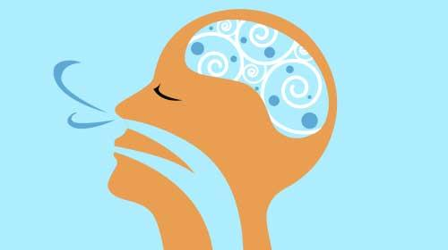
Responsible Decision-Making
Presenter name
Email
Phone
www.projectevers.org
Notes:
Thank you so much for your time and attention. Any questions/comments?

