Slide 1
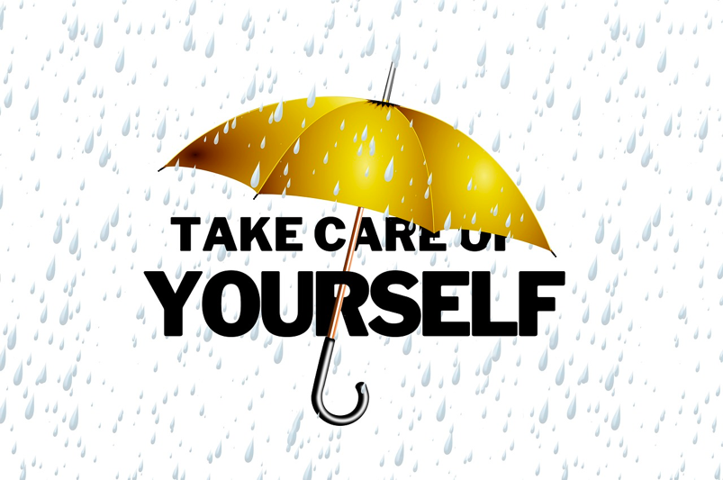
Self-Care - Project EVERS
Self-Care Strategies
Put Yourself First
(It’s okay!)
Presenter, title, organization
www.projectevers.org
Notes:
Educators who work with trauma survivors in an open, engaged, and empathic way and who feel responsible or committed to helping them are likely to experience indirect trauma.
It’s sometimes very easy to be transformed by the work that we do… in both positive and sometimes negative ways.
Self care is a necessity – not a luxury – in our line of work.
According to research studies and anecdotal evidence alike, stress among educators is widespread – and perhaps increasing.
We always encourage you to work in partnership with each other to help ensure that you take care of you.
These tips are intended to help you maintain your desire to give of yourself AND take care of yourself.

Slide 2
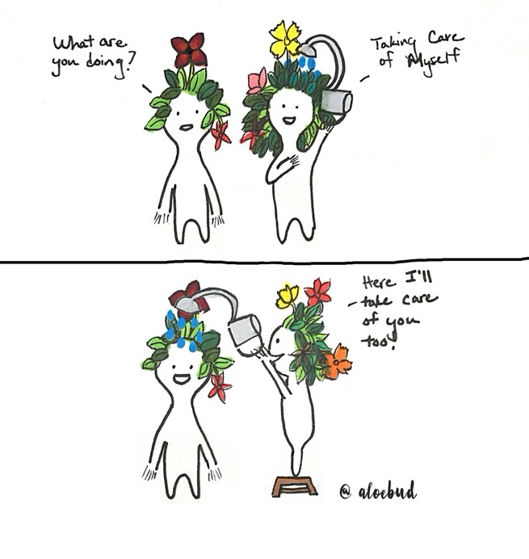
Self-Care
Today you will learn:
About self-care and compassion fatigue, and how it
applies to you
How to recognize and understand the signs of
compassion fatigue
How to maintain a work/life balance
To understand the stresses that helping
professions face
To discover the continuum of compassion fatigue
About self-care strategies
To make a self-care plan
www.projectevers.org
Notes:
The objectives for today’s session are:
Learn about self-care and compassion fatigue, and how it applies to you
Recognize and understand the signs of compassion fatigue
Learn how to maintain a work/life balance
Understand the stresses that educators face
Discover the continuum of compassion fatigue
Learn about self-care strategies
Make a self-care plan!

Slide 3
Self-Care
What is Self-Care?
Self-care is the practice of taking action to preserve or improve one’s own health and taking an active role in protecting your own well-being and happiness when facing stressful or difficult situations.
It is defined as a balanced spectrum of feelings and attitudes associated with positivity, feeling grateful and upbeat, and being able to express appreciation and liking.
Organizational self-care is equally important.
www.projectevers.org
Notes:
While self-care has been a main concept of practice to keep a healthy work/life balance among educators and other essential service providers, it continues to be the “missing” piece for many in their daily work as teachers, counselors, or advocates.
Self-care is an important mechanism for educators to increase positive affect by changing our thoughts, physical, intellectual, and social resources
The opposite would be negative affect or negativity commonly associated with feelings of irritability and expressing dislike and the narrowing of people’s views.
Equally Important is organizational self-care - the role that agencies play to facilitate self-care for educators and service providers in terms of classroom size, caseloads, supervision, and overall providing a friendly and supportive working environment; in contrast to individual self-care where we can engage in self- reflection, exercise, socializing with friends and family and even seeking personal counseling.

Slide 4
Self-Care
Vocabulary
Work-Related Traumatic Stress
Primary traumatic stress; direct target of event
Secondary traumatic exposure to event due to a relationship with the primary person
Compassion Satisfaction
Positive feelings of working with others; development of personal strengths as a result
Compassion Fatigue
The weariness that can come from caring (Johnson, 1997)
Burnout
Physical and emotional exhaustion
www.projectevers.org
Notes:
Let’s talk about the difference between self-care, compassion satisfaction, and compassion fatigue,
Indirect trauma can be a cumulative response to working with many trauma survivors over time. The signs and symptoms of indirect trauma resemble those of direct trauma. You may experience intrusive imagery, avoidance, or anxiety… or disruptions in personal or professional relationships, managing boundaries, or regulating or checking your own emotions.
You might be more likely to experience compassion fatigue or job burnout if:
You identify so strongly with work that you lack balance between your work life and your personal life
You have a high workload, including overtime work
You try to be everything to everyone
You work in a helping profession, such as health care
You feel you have little or no control over your work

Slide 5
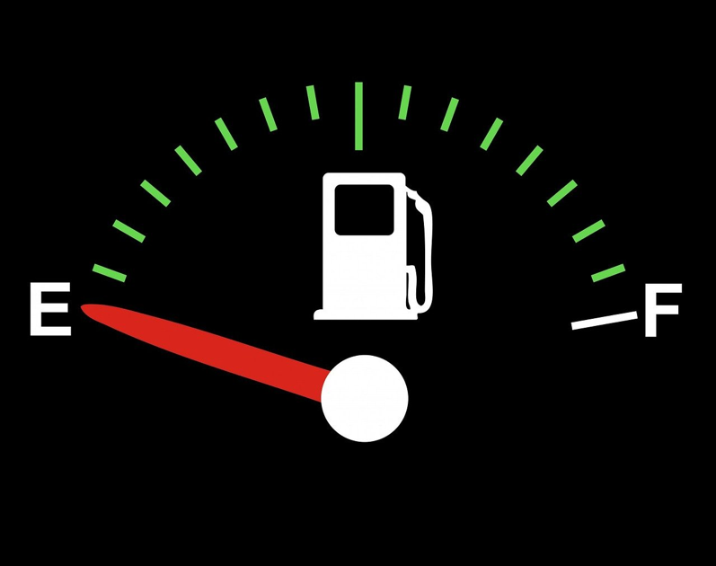
Self-Care
Compassion Fatigue
www.projectevers.org
Notes:
It is vital to understand that we must take care of ourselves in order to effectively help others.
As someone who works as a “first responder” to anyone exposed to trauma you can easily experience secondary trauma, sometimes referred to as compassion fatigue. Think about it…you witness mental and emotional trauma on the job, often on a daily basis. Spending time with students or colleagues who are distressed is bound to affect your own emotional state.
Knowledge is power. An easy analogy to consider is when taking a flight, the flight attendants always remind you to put your oxygen mask on first before assisting others. Why do they say that? What could possibly be wrong with helping others first? After all, helping other is what we do…
In the case of the airplane, oxygen masks are deployed in situations where the oxygen level has dropped dangerously low. Without oxygen masks, we could quickly lose consciousness. If we don’t make putting on our mask our first priority, we will very likely not be able to help anyone for very long.
The same theory holds true for our daily lives. If we become overwhelmed or incapacitated, we’re of no help to others. When helping comes at the expense of our own physical and mental health, the result is quite often burnout. Some feelings that often accompany giving too much are exhaustion, frustration, and anger, along with possibly feeling ineffective, helpless, or hopeless.

Slide 6
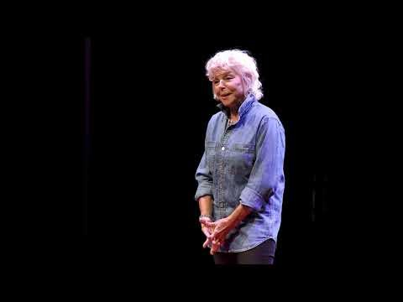
Compassion Fatigue: What is it and do you have it?
Self-Care
www.projectevers.org
Notes:
https://www.youtube.com/watch?v=v-4m35Gixno
Let’s watch this video to further define compassion fatigue.
NOTE: this video is approximately 12 ½ minutes in length.
In this compelling talk, Juliette Watt introduces us to “Compassion Fatigue," a pervasive syndrome that affects people like us. Juliette herself has suffered from Compassion Fatigue first-hand and she is very passionate about sharing the insidious nature of this syndrome and the devastating effects it can have on your life. Compassion Fatigue can happen to any age group from people in their twenties right up to their senior years. It is an important, critical topic that Juliette has pulled out of the shadows so that we can recognize the symptoms and develop a renewed resilience to teach ourselves how to continue to give compassion without sacrificing ourselves and our lives.

Slide 7
Self-Care
Signs of Compassion Fatigue
Exhaustion
Reduced ability to feel sympathy or empathy
Anger or irritability
Increased use of drugs and alcohol
Dread of working with certain clients
Diminished sense of enjoyment of career
Disruption to world view
www.projectevers.org
Notes:
As underscored in the video, we need to recognize and understand the signs of compassion fatigue. They are very often the same common responses that a person who has been traumatized by other events feel:
• Deep sadness
• Irritability / Anger
• Self-blame
• Nervousness
• Increased Anxiety
• Confusion
• Negative thoughts
• Relationship problems
• Problems sleeping
To avoid burnout, managing our self-care is a key responsibility to maintain our happiness, our physical health, and our mental health.
It requires conscious planning and follow-through to include time in our day to attend to our own needs and make that time a priority.
If we don’t, we eventually won’t be able to care for others.

Slide 8
Self-Care
Who is Vulnerable to Compassion Fatigue?
Helpers who:
Are empathetic
Have experienced some painful or traumatic event(s) in their own lives which are unresolved and, in turn, activated by similar reports of pain/trauma in others
Work directly with the painful/traumatic experiences of children
Take care of others and often neglect or are unaware of their own feelings and needs
www.projectevers.org
Notes:
All helpers are vulnerable! Which in our line of work means everyone is somewhat vulnerable to compassion fatigue!
To avoid burnout, managing our self-care is a key responsibility to maintain our happiness, our physical health, and our mental health.
It requires conscious planning and follow-through to include time in our day to attend to our own needs and make that time a priority.
If we don’t, we eventually won’t be able to care for others.

Slide 9
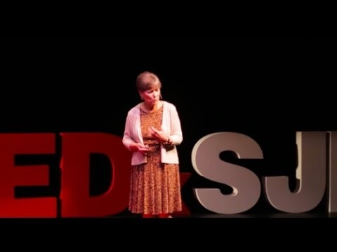
How to Manage Compassion Fatigue in Caregiving
Self-Care
www.projectevers.org
Notes:
Https://www.youtube.com/watch?time_continue=40&v=7keppA8XRas&feature=emb_logo
NOTE: this video is approximately 17½ minutes in length.
Caregivers are often so busy caring for others that they tend to neglect their own emotional, physical, and spiritual health. Studies confirm that caregivers play host to a high level of compassion fatigue. In this insightful talk, Patricia Smith suggests the path to wellness begins with awareness, and recommends simple self-care measures such as regular exercise, healthy eating habits, enjoyable social activities, journaling, and restful sleep. With support, insightful information, and authentic self-care, caregivers can begin to understand the complexity of the emotions they've been juggling and, most likely, suppressing.
Patricia is the founder of the Compassion Fatigue Awareness Project© (www.compassionfatigue.org), Patricia Smith writes, speaks and facilities trainings nationwide in service of those who care for others. With a background in journalism, she has authored books and training materials including the award-winning To Weep for a Stranger: Compassion Fatigue in Caregiving. This talk was given at a TEDx event using the TED conference format but independently organized by a local community.

Slide 10
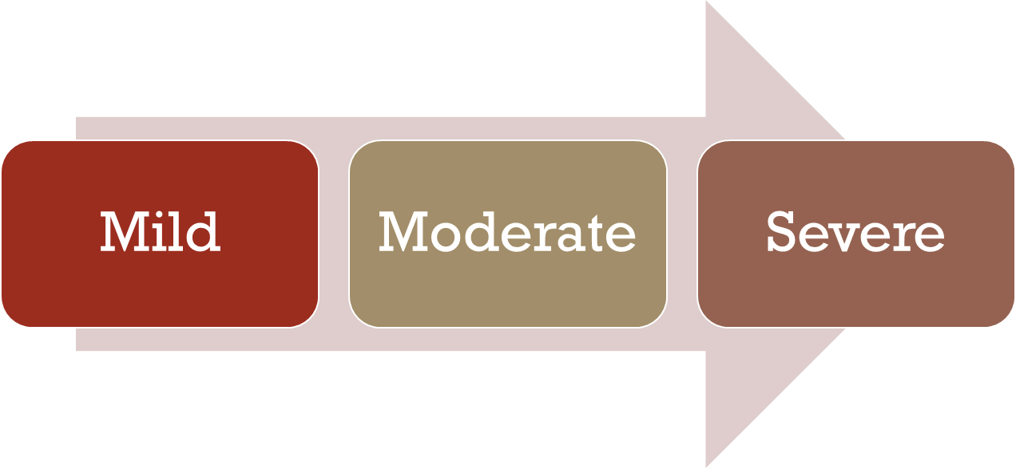
Self-Care
Continuum on Compassion Fatigue?
www.projectevers.org
Notes:
As with most health issues, both the severity and impact of compassion fatigue can range from mild to severe.
People on the continuum of compassion fatigue may withdraw from others, become hopeless, have nightmares or difficulty sleeping. They may overeat, overuse alcohol, or turn to other self-destructive behaviors. On the severe end of indirect trauma, people become at risk for being ineffective in their work, violating boundaries in helping relationships, withdrawing from friends, family and colleagues or making bad judgements. They may experience burnout – too many leave the field prematurely.
We want increased awareness among staff to make sure that interventions come into play during the early or mild stages of fatigue.
Attend to basic self-care and seek to balance work, play, and rest.
All of us already have coping skills – unique coping skills!
Use whatever it is that works best for you.
What helps you reconnect with whatever in life is meaningful to you? What gives you purpose without draining every ounce of energy and hope?

Slide 11
Self-Care
Compassion Fatigue Signs for Educators
Increased irritability or impatience with students
Difficulty planning classroom activities and lessons
Decreased concentration
Denying that traumatic stress impacts students or feeling numb and detached
Intense feelings and intrusive thoughts, that do not lessen over time, about a student’s trauma
Dreams about student trauma
Source: National Traumatic Child Stress Network: Child Trauma Toolkit for Educators, Oct 2008
www.projectevers.org
Notes:
According to the Compassion Fatigue Project. “Denial is one of the most detrimental symptoms of compassion fatigue and life stress. It can
easily hinder your ability to assess the level of fatigue and stress in your life, as well as thwart your efforts to begin the healing process.”

Slide 12
Self-Care
Tips for Educators
Don’t go it alone!
Recognize compassion fatigue as
an occupational hazard.
Seek help with your own traumas.
If you see signs, talk to a
professional.
Attend to self-care.
www.projectevers.org
Notes:
Trauma, including secondary trauma, can be isolating. While respecting confidentiality, get support from your team, talk to others in your organization.
Compassion fatigue is not a sign of weakness or incompetence, it’s the cost of caring.
Don’t judge yourself as weak or incompetent for having strong reactions to student’s trauma
If you have experienced trauma, working with a student with trauma could re-traumatize you and make you are more at risk for compassion fatigue
If you have compassion fatigue for more than two or three weeks, seek counseling from a professional who is knowledgeable about trauma
Guard against your work being the only activity that defines who you are.
Keep perspective by working with students who have not experienced trauma.
Eat well engage in exercise and fun activities.
Take a break! Find time to self-reflect.
It’s okay to cry, but find things that make you laugh.

Slide 13
Self-Care
Behaviors to Avoid
Blaming others
Ignoring the problem
Constant complaining to coworkers, friends, and family
Neglecting needs, interests, and desires
Reducing leisure activities
Self-medicating
Making drastic and rash decisions
“Toughing it out”
www.projectevers.org
Notes:
We need to deal directly and acknowledge the compassion fatigue and avoid behaviors that are not helpful.

Slide 14
Self-Care
Self-Compassion
What it is not:
Self-pity
Self-indulgence
What it is:
Self-kindness vs. self-judgment
Common humanity vs. isolation
Mindfulness vs. over-identification
www.projectevers.org
Notes:
It Is NOT:
Self-pity or self-indulgence
A sign of weakness or that you can’t accept things
Ignoring areas of improvement
It IS:
Practicing kinder self-talk; less judgment (how would you react to a friend if they told you what they were going through)
Focusing on what brings us together vs. the things that divide us (understanding that we’re all trying to make things work and identifying what we can learn from situations)
Mindfulness and acceptance for ourselves and others (and we’re going to talk about this more in a few moments, about how can we can be vulnerable and know that this is a good thing)
PRACTICE: Let’s practice a little self-compassion by walking through a practice that was adapted from a great article from Mindful Schools (written by Jill Guerra, entitled “Empower Your Students with Self-Compassion”).
ACTIVITY:
Begin by thinking about a time that you were mad or frustrated at yourself for something that didn’t go well.
Then begin to use some self-compassion language (ex: “I am learning,” “Everyone makes mistakes,” “I tried my best,” etc.) and see if you notice what it feels like in your body to use that softer language with yourself.
We encourage you to take a sticky note and write a phrase showing yourself some self-compassion and place them on or near your computer screen as a reminder to maintain perspective.

Slide 15
Self-Care
At work – Providing Professional Development on self-care/mindfulness
At home – Practice mindfulness strategies, do fun things, remember you are worthy of care too
Self-preservation mindset – Identify what you wish to do versus what you can actually do and provide a safe environment
Strong peer network – Work culture
www.projectevers.org
Notes:
What do we really need to maintain our physical and mental health? Exercise, good nutrition, alone time, social time, time for creative endeavors, medical care, and support groups are just a few ideas to consider.
We may have become so accustomed to dealing with the immediate needs of others that it might feel wrong to give priorities to our own needs, but doing so is critical.
If we don’t take care of ourselves, who will? It’s vital to understand that we have to take care of ourselves in order to effectively help others.
To avoid burnout, managing your self-care is a key responsibility to maintain your own happiness, your physical health, and your mental health.
It requires conscious planning and follow-through to include time in your day to attend to your own needs and make that time a priority.
If we don’t, we eventually won’t be able to care for others.
Develop strategies for work, home, and play…and keep yourself at the center of all personal goals.

Slide 16
Self-Care
Evidence-Informed Practices for Educators
Self-Preservation Mindset - identify what you wish you could do versus what you can actually do
Restorative Justice - building relationships, rather than punishing
Growth Mindset - belief that most basic abilities can be developed through dedication and hard work—brains and talent are just the starting point
www.projectevers.org
Notes:
You cannot eradicate or prevent all suffering for your students. But you can show up each day, support your students, advocate for them, and love them.
There are five evidence-informed practices to avoid compassion fatigue in educators and to help you when working with students: self-preservation mindset, restorative justice, growth mindset, mindfulness, and vicarious resilience.
Self-Preservation Mindset - identify what you wish you could do versus what you can actually do
Restorative Justice - Building relationships, rather than punishing
Growth Mindset - belief that most basic abilities can be developed through dedication and hard work—brains and talent are just the starting point

Slide 17
Self-Care
Evidence-Informed Practices for Educators
Mindfulness - Feeling more grounded in our bodies and in the present moment. Take a 30- second vacation!
Vicarious Resilience - Strengths-focused concept that does not ignore or supplant compassion fatigue or burnout, but instead offers a counterbalance
www.projectevers.org
Notes:
Mindfulness - Feeling more grounded in our bodies and in the present moment. Take a 30-second vacation!
Vicarious Resilience - strengths-focused concept that does not ignore or supplant compassion fatigue or burnout, but instead offers a counterbalance

Slide 18
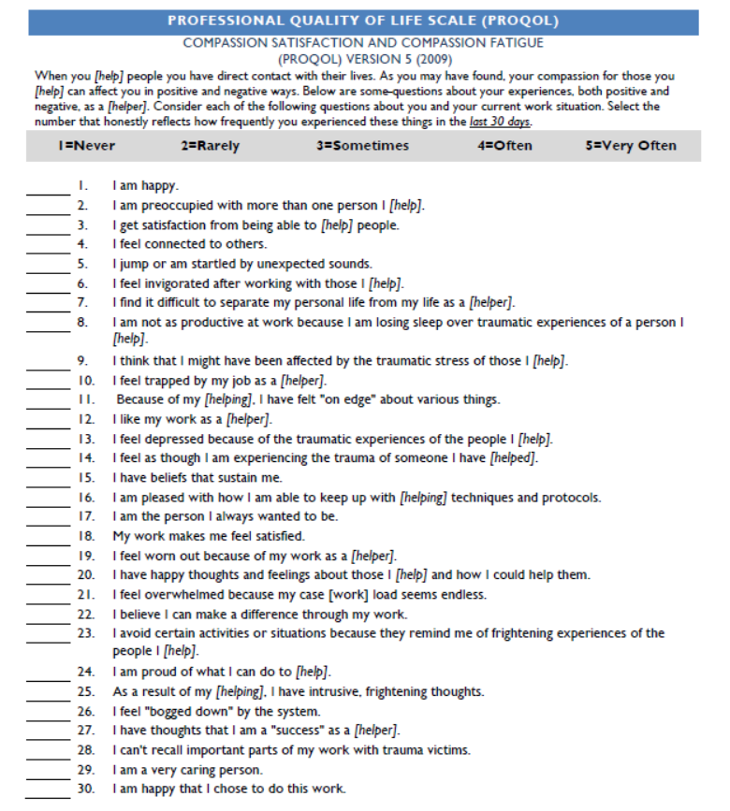
Self-Care
Activity:
Professional
Quality of
Life Scale
(PROQOL)
www.projectevers.org
Notes:
The PROQOL is a 30-question survey to assess the effect that trauma may be having in our professional lives.
Your scores include scores on compassion satisfaction, burnout, and secondary trauma.
Do this activity if you have time.
It may not be appropriate if presenting online.

Slide 19
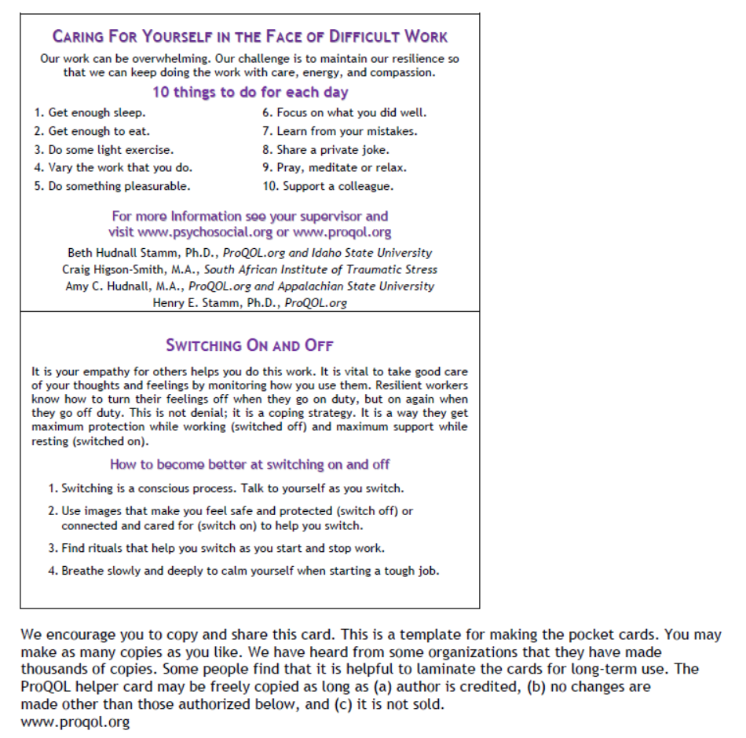
Self-Care
Activity:
The Helper
Pocket
Card
www.projectevers.org
Notes:
The pocket card was created for educators/school staff to carry as a reminder of how important it is to take care of yourself and those working with you.
The strategies suggested are based on the experiences of other people working in crisis settings and on research from around the world.
The goal is to help improve resilience and increase the positive aspects of helping and reduce the negative ones. In addition, it helps promote compassion satisfaction and reduce compassion fatigue, secondary trauma, and vicarious traumatization.
Please feel free to print as many copies as you like and to share this card with others.

Slide 20
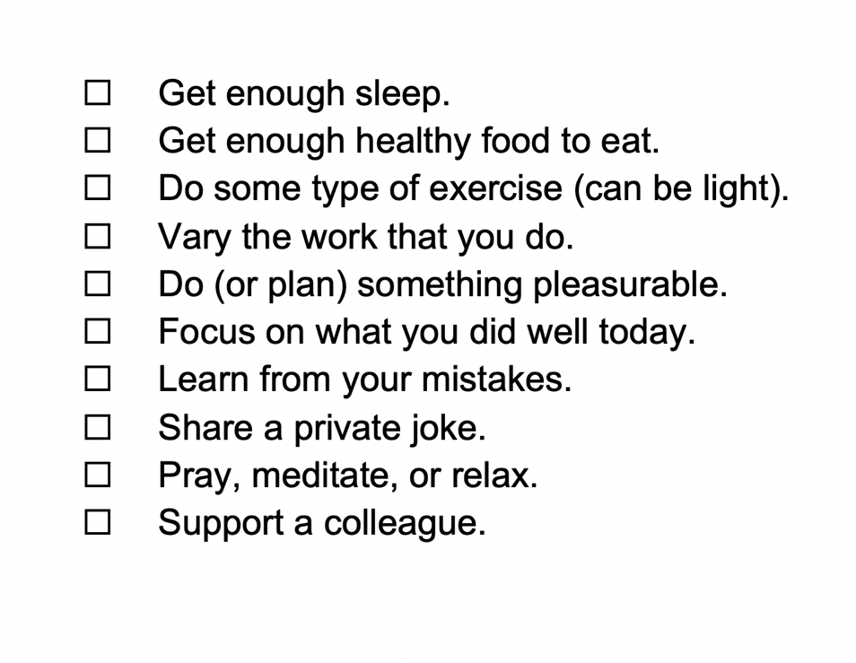
Self-Care
Activity:
Caring for Yourself in the Face of Difficult Work
www.projectevers.org
Notes:
Objectives:
Highlight that the work of a service provider can be overwhelming.
Focus on the importance of resilience in order to continue the work with care, energy, and compassion.

Slide 21
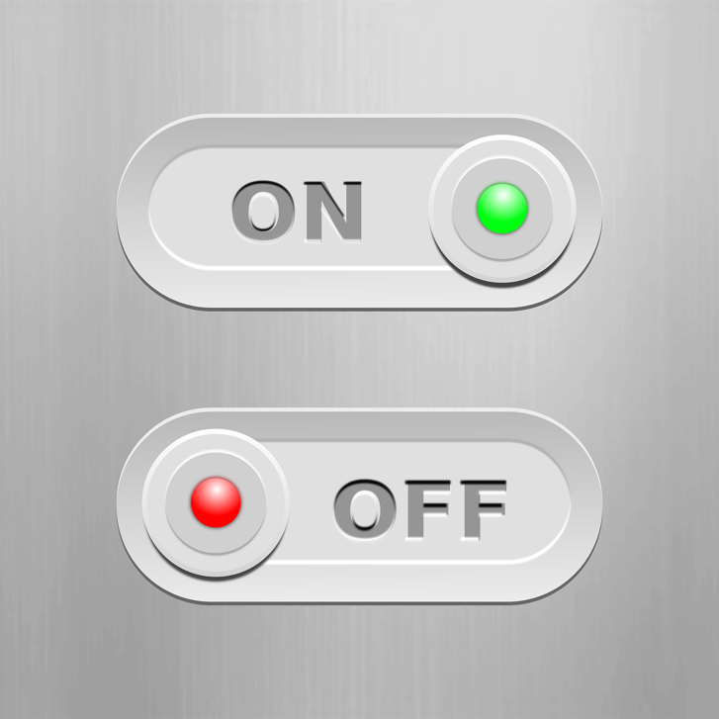
Self-Care
Activity:
Switching
On and Off
www.projectevers.org
Notes:
Objectives:
Understand that resilient workers know how to switch their feelings off when they go on duty, and on again when they go off duty.
Define the idea of a coping strategy – it is not denial, but instead a way for individuals to get maximum protection while working (switched off) and maximum support while resting (switched on).

Slide 22
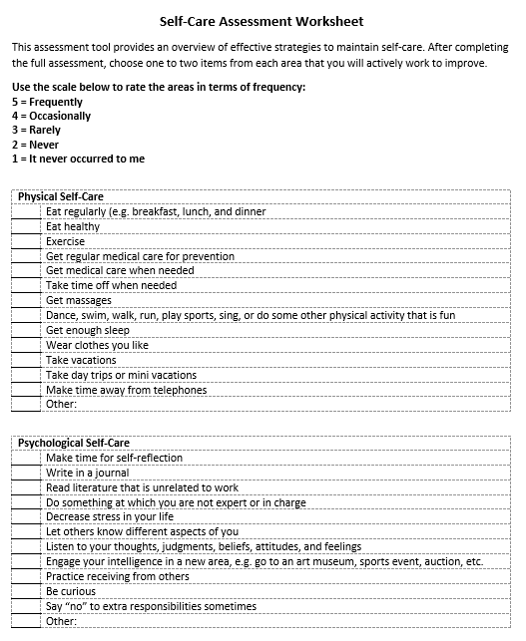
Self-Care
Activity:
Self-Care
Assessment
Worksheet
www.projectevers.org
Notes:
As a service provider, you need to take care of yourself; you owe it to yourself and those who care about you.
Even when work or personal demands are high, remember you are not superhuman.
You need to set limits.
Identify effective strategies to maintain self-care.
Practice different ways to recharge.

Slide 23
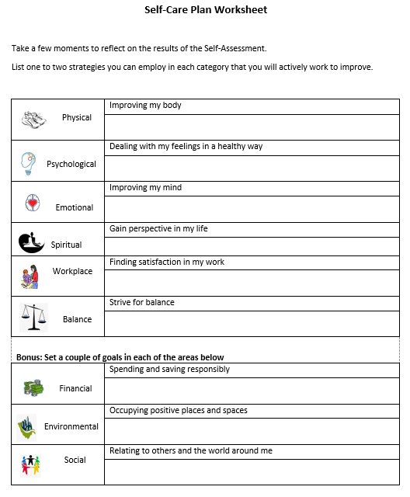
Self-Care
Activity:
Self-Care
Plan
Worksheet
www.projectevers.org
Notes:
Take a few moments to think about each of the categories in the Self-Care Assessment.
Based on your scores, choose one or two items from each area that you will actively work to improve.
This is a great opportunity to challenge yourself to do something new! There’s no better time than now.
Identify areas of self-care.
Practice different ways to recharge

Slide 24
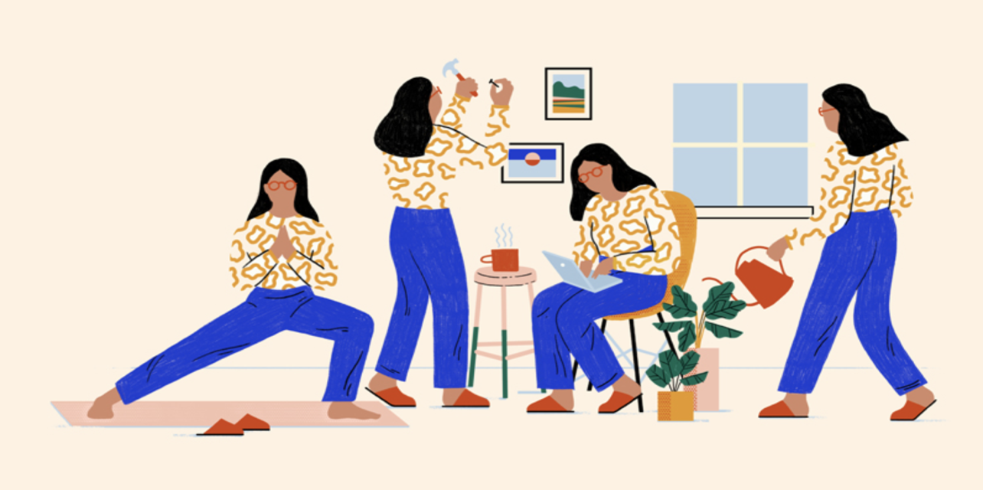
Self-Care
What Are Your Self-Care Habits?
www.projectevers.org
Notes:
Now that you have heard about self-care strategies, think about what you can incorporate on your daily routines to help yourself before you help others.
Discussion slide; Name one thing you’re going to do in the next week to ground yourself.

Slide 25
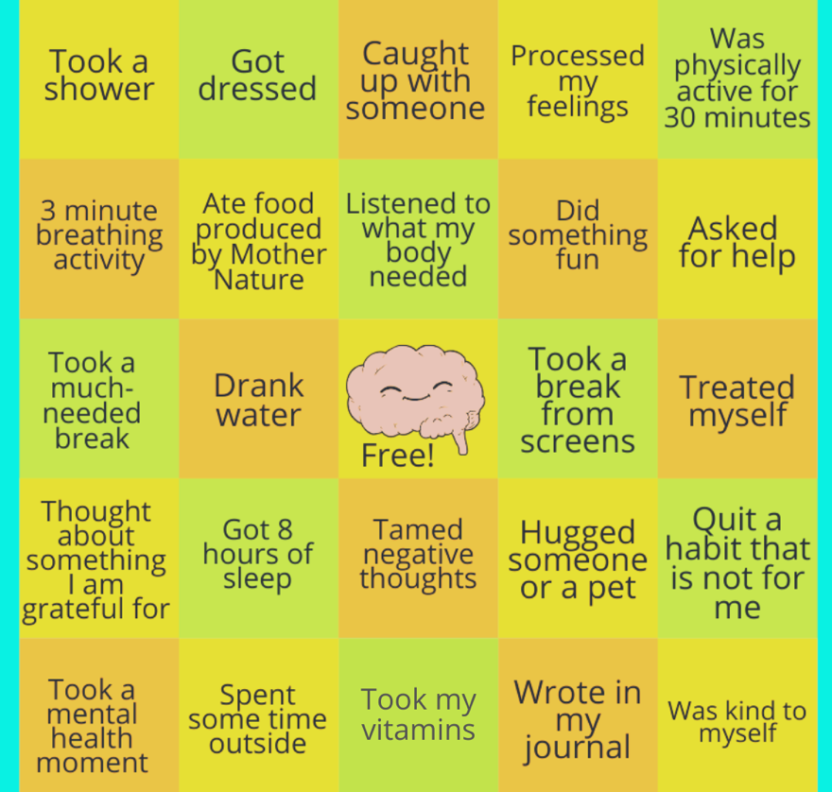
Self-Care
Activity:
Self-Care Bingo!

Slide 26
Self-Care
The 8 Laws Governing Self-Care
#1 By validating ourselves, we promote acceptance.
#2 By validating others, we elevate ourselves.
#3 By meeting our own mental, physical, and emotional needs, we give care from a place of abundance, not scarcity.
#4 By practicing self-goodwill, we manifest it throughout our lives.
#5 By honoring past traumas and hurts, we allow ourselves freedom from the pain that controls us.
#6 By “doing the work,” we reclaim the personal power that is rightfully ours.
#7 By naming and taking ownership of the core issues that limit our growth, we create authenticity.
#8 By managing our self-care, we welcome happiness into our lives.
http://www.healthycaregiving.com/pages/TheEightLaws.pdf
www.projectevers.org
Notes:
Let’s go over the eight laws governing self-care.

Slide 27
Self-Care
The 8 Laws Governing Healthy Change
#1 Take frequent breaks from what you are doing.
#2 Learn the word “no”. Use it whenever necessary.
#3 Share the load with others.
#4 There is humor in every situation. Find it and laugh.
#5 Recognize when you need help. Ask for it.
#6 Give yourself credit when credit is due.
#7 Give others credit when credit is due.
#8 Breathe deeply as often as possible.
http://www.healthycaregiving.com/pages/TheEightLaws.pdf
www.projectevers.org
Notes:
Let’s go over the 8 laws governing healthy change.

Slide 28
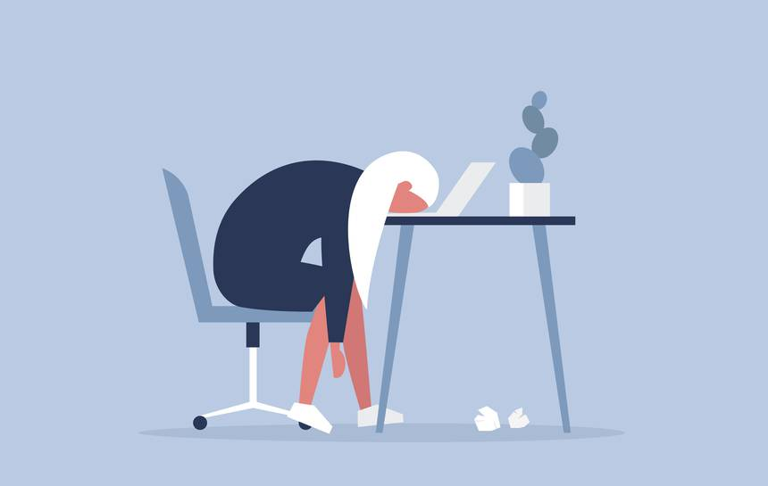
Self-Care
Job Burnout
Job burnout is a special type of work-related stress – a state of physical or emotional exhaustion that also involves a sense of reduced accomplishment and loss of personal identity.
https://www.mayoclinic.org/healthy-lifestyle/adult-health/in-depth/burnout/art-20046642
www.projectevers.org
Notes:
The source of this definition and information is the Mayo Clinic. We urge you to look at the website for detailed information.
Job Burnout Symptoms
Ask yourself:
Have you become cynical or critical at work?
Do you drag yourself to work and have trouble getting started?
Have you become irritable or impatient with co-workers, students, others?
Do you lack the energy to be consistently productive?
Do you find it hard to concentrate?
Do you lack satisfaction from your achievements?
Do you feel disillusioned about your job?
Are you using food, drugs, or alcohol to feel better or to simply not feel?
Have your sleep habits changed?
If you answered yes to any of these questions, you might be experiencing job burnout. Consider talking to a doctor or a mental health provider because these symptoms can also be related to health conditions, such as depression.
Handling Job Burnout – Take Action.
Evaluate your options, but don’t quit!
The “don’t quit” advice is our own… not the Mayo Clinic’s advice. You will want to discuss specific concerns with your supervisor. Maybe you can work together to change expectations or reach compromises or solutions.
Seek support (friends / family, colleagues).
Try a relaxing activity (yoga, mediation, tai chi)
Get some exercise
Get some sleep
Sleep restores well-being and helps protect your health.
Keep an open mind as you consider the options. Do not let a demanding or unrewarding job undermine your health.

Slide 29
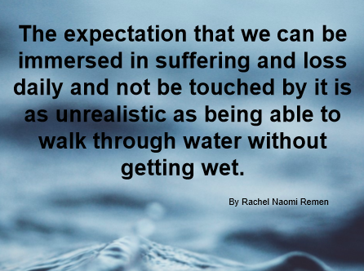
Self-Care
www.projectevers.org
Notes:
Read quote: “The expectation that we can be immersed in suffering and loss daily and not be touched by it is as unrealistic as expecting to be able to walk through water without getting wet.” Dr. Naomi Remen

Slide 30
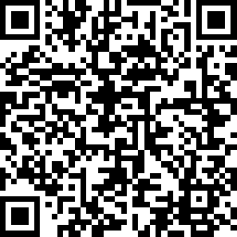
Trauma
Please use the link to fill out an evaluation. Thank you!
www.projectevers.org
Notes:
Ask your participants to complete the simple evaluation.

Slide 31
Self-Care
Presenter name
Email
Phone
www.projectevers.org
Notes:
It has been my pleasure to be here with you today!
Feel free to reach out.
Thank you for your time and attention.

