Slide 1
Project EVERS
Adverse Childhood Experiences (ACEs)
Presenter, title, organization
www.projectevers.org
Notes:
An understanding of Adverse Childhood Experiences (ACEs) is vital to anyone seeking an understanding of the effects of trauma in students’ lives and how to offer trauma-informed care.
This module focuses on common responses that occur in reaction to ACEs when an individual’s coping abilities are overwhelmed as they experience an adverse event or series of events.
ACEs appear in many forms and can affect brain development, behavior, and learning. These effects convey life-long implications for health.
Childhood trauma is not something one just “gets over” as one ages.
The repeated stress of abuse, neglect, and family members struggling with mental health or substance abuse issues has real, tangible effects on the development of the brain.
These effects unfold across a lifetime, exposing those who have experienced high levels of trauma to the risk of chronic physical health issues, depression, and other mental health struggles.

Slide 2
Adverse Childhood Experiences (ACEs)
Today you will learn to:
Understand the importance of resilience in the lives of students affected by ACEs.
Understand the role that ACEs plays in the lives of students and families.
Learn to use the ACEs Questionnaire to determine personal ACEs scores.
www.projectevers.org
Notes:
Today we will:
Understand the importance of ACEs in the lives of students and families
Learn to use the ACEs Questionnaire to determine personal ACEs scores.

Slide 3
Adverse Childhood Experiences (ACEs)
Today you will learn to:
Determine the appropriate resources to connect with when helping others determine their ACEs score and any resulting mental/emotional/physical health issues.
www.projectevers.org
Notes:
Today we will:
Determine the appropriate resources to connect with when helping others determine their ACEs score and any resulting mental/emotional/physical health issues

Slide 4
Adverse Childhood Experiences (ACEs)
What are ACEs?
ACEs =Adverse Childhood Experiences
These are traumatic or stress-inducing experiences that happen before adulthood and affect brain chemistry, especially with prolonged exposure.
Having a score of four (4) or more ACEs has been linked to developing alcoholism, drug abuse, depression, and chronic illness in adulthood.
Let’s take a look at the different types of ACEs.
www.projectevers.org
Notes:
You may have heard of ACEs when reading/learning about stress and anxiety.
ACEs stands for Adverse Childhood Experiences.
These prolonged adverse experiences during childhood can create toxic stress which may negatively impact brain development.
ACEs are put into three categories:
Abuse
Neglect
Family/household dysfunction
Children who experience multiple adverse experiences are at risk to later develop problems like drug and alcohol abuse, depression, or chronic illness.

Slide 5
Adverse Childhood Experiences (ACEs)
ACEs
categories
Notes:
ACEs are divided into 3 categories:
Abuse
Neglect, and
Family/household challenges, such as mental illness of or substance abuse by a caregiver
ACEs types –abuse (physical, emotional, sexual), neglect (physical or emotional), and household disruption (Incarcerated Relative / Mental Illness / Mother treated violently / Substance Abuse)
Having a score of four or more ACEs has been linked to developing alcoholism, drug abuse, depression, and chronic illness in adulthood. Let’s take a look at the ACEs questionnaire.

Slide 6
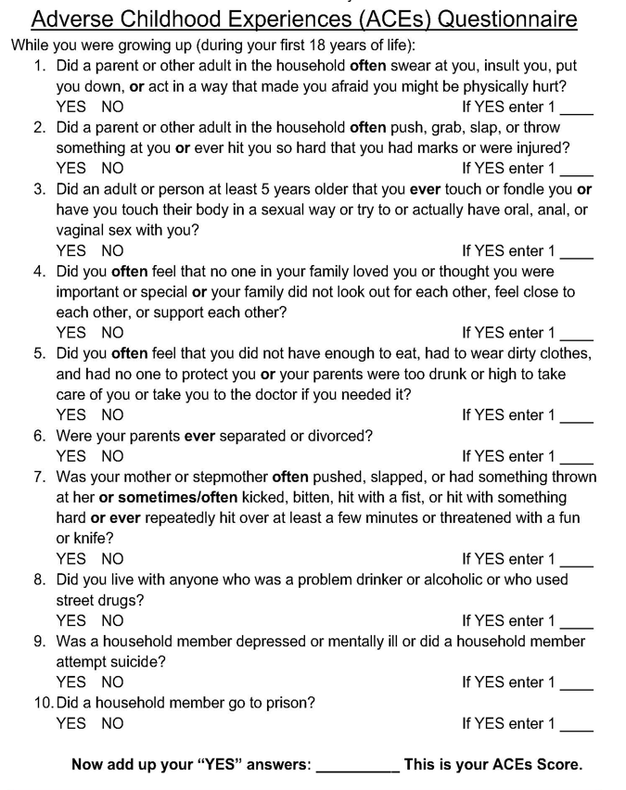
Adverse Childhood Experiences (ACEs)
ACEs Questionnaire
Take the ACEs Questionnaire.
Think about yourself or someone you love.
There is no need to share the results.
Did someone in your life make a difference in improving outcomes?
Notes:
Objective:
Self-knowledge is the first step toward recognizing the effects of ACEs on a personal level and realizing the need to develop strategies that help to cope, calm, and heal.
The ACEs Questionnaire is a valuable tool widely used to help individuals determine their own personal ACEs score.
Let’s take the ACEs Questionnaire to privately assess our own ACEs scores.
1. Distribute the questionnaire and pens/pencils to each participant.
2. Briefly explain the purpose of the questionnaire and reassure participants they will not be required to share their results with anyone.
3. Allow time for each participant to complete the questionnaire.
4. Explain how each person may determine their score.
5. Ask the following questions for quiet reflection:
a. Did you realize anything that you were not expecting?
b. Are you surprised at your final score?
c. Do you believe your own ACEs score influences your level of personal well-being?

Slide 7
Adverse Childhood Experiences (ACEs)
Effects of ACEs Beyond Childhood
www.projectevers.org
Notes:
Objective:
Explore how Adverse Childhood Experiences (ACEs) can result in challenges during adulthood. Childhood abuse can have far-reaching effects. From insecurities to intimacy issues, from not daring to trust people to difficulties making friends, the effects of childhood abuse can show in any area of your life.
Watch the video 7 Ways Childhood Trauma Follow You into Adulthood.
2. Following the video, review the seven (7) ways childhood trauma can follow you into adulthood:
a. You do not remember your younger years.
b. You find yourself in toxic relationships.
c. You feel like you do not deserve love at all.
d. You develop passive aggressiveness.
e. Negative self-talk is amplified.
f. You ride an emotional rollercoaster.
g. You do not know who you are.
3. Ask the following questions of the group:
a. Do we know students who express these behaviors?
b. How can we educate students regarding these lasting impacts?

Slide 8
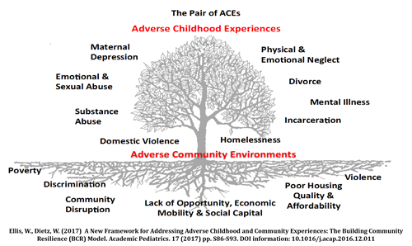
Adverse Childhood Experiences (ACEs)
ACEs
on the Surface and Beneath
Notes:
We just discussed the types of ACEs, let’s now dig a little deeper.
The types of ACEs are all on the surface, however, it is important also to look at the root causes that put children at risk of experiencing ACEs.
These root causes have to do with the environment, specifically the communities where children grow up, as well as circumstances.
These are:
Poverty
Discrimination
Community Disruption
Lack of opportunity, economic mobility, and social capital
Poor housing quality and affordability
Violence
A lot of these underlying causes are very common to the rural student population.

Slide 9
Adverse Childhood Experiences (ACEs)
www.projectevers.org
Notes:
This graphic from the Centers for Disease Control (CDC) illustrates the lasting impacts of ACEs.
The areas of impact are:
Injury
Mental health
Maternal health
Infectious diseases, such as STDs
Chronic diseases, such as cancer and diabetes
Risky behaviors, such as drug and alcohol abuse
And opportunities, such as education attainment.

Slide 10
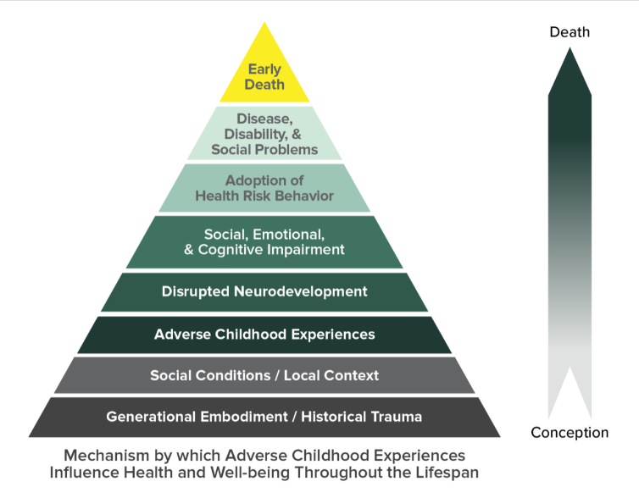
Adverse Childhood Experiences (ACEs)
ACEs
Pyramid
Notes:
The ACEs Pyramid represents the life course model of the ACEs Study: ACEs can lead to impaired neurodevelopment, which in turn leads to social-emotional and cognitive adaptations that can then lead to the risk factors for major causes of disease, disability, social problems, and early death.
The arrow shows how Adverse Childhood Experiences can lead to those risk factors to the health and social consequences higher up the pyramid.

Slide 11
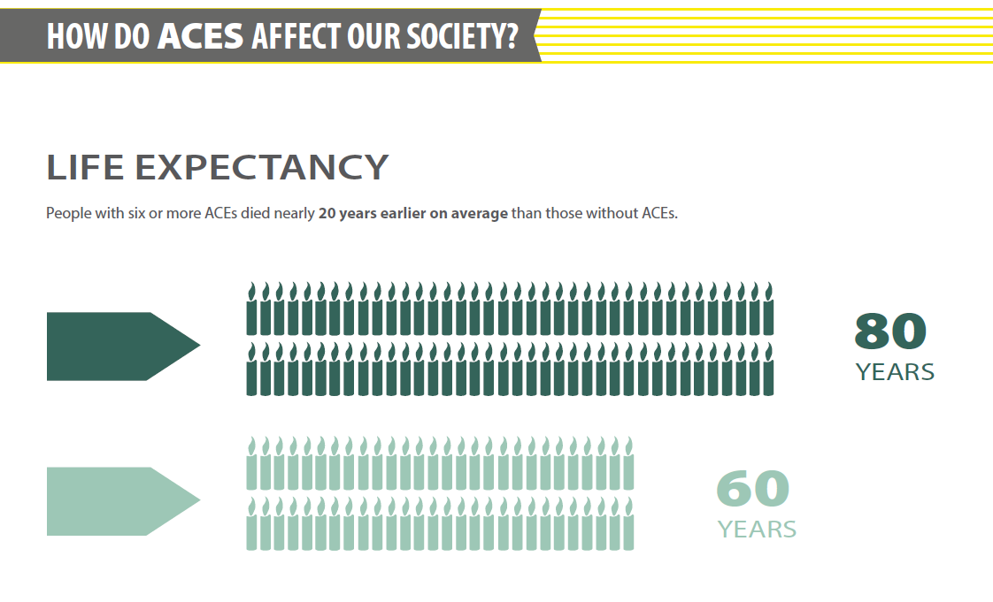
Adverse Childhood Experiences (ACEs)
ACEs Life Expectancy
Notes:
As you can see by the graphic, life expectancy is severely affected by ACEs.

Slide 12
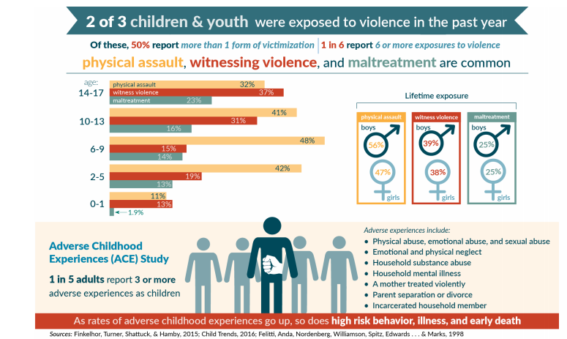
Adverse Childhood Experiences (ACEs)
Prevalence of Childhood Trauma
Notes:
ACEs are pervasive.
According to the ACEs study, two of three children were exposed to violence and one in five adults report a score of 3 or more.

Slide 13
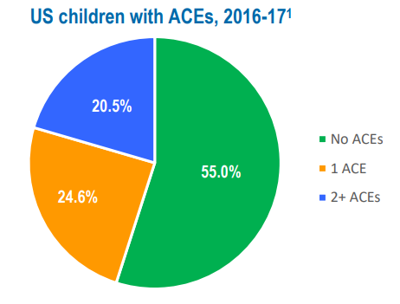
Adverse Childhood Experiences (ACEs)
https://www.cahmi.org/wp-content/uploads/2019/06/CAHMI-State-Fact-Sheet-National.pdf
www.projectevers.org
Notes:
Over 45% of US children and two-thirds of adults have been exposed to at least one Adverse Childhood Experience—such as physical or emotional neglect or abuse, living with someone with a drug, alcohol or serious mental health problem, the death of a parent and being exposed to violence or discrimination in the home or community.
More than one in five children have a score of 2+ ACEs.
Breakthrough neurobiological sciences explain the link between ACEs exposure levels to markedly higher rates of chronic physical illnesses, mental, emotional, and behavioral health problems, and lowered quality of life and life expectancy.
Hope lies in the realization that methods to prevent and heal the legacy and effects of trauma from ACEs are available.

Slide 14
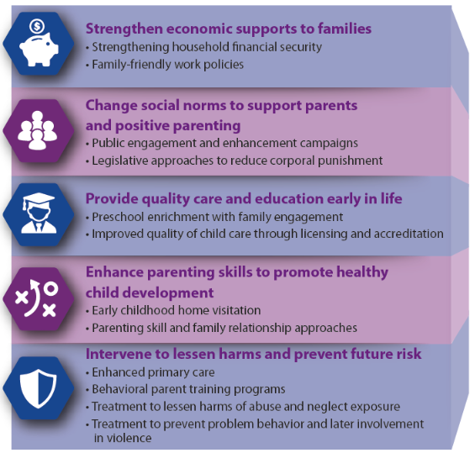
Adverse Childhood Experiences (ACEs)
The Effects of ACEs
Can be Prevented
Notes:
ACEs can be prevented if we provide support to parents/communities that have some of the risks mentioned earlier.
Some ways we can help are:
Providing economic opportunities
Parenting help
Access to early childhood programs
Access to physical and mental health resources

Slide 15
Adverse Childhood Experiences (ACEs)
www.projectevers.org
Notes:
There are a number of ways that parents, caregivers, teachers, and other service providers may be able to help students who have experienced traumatic stress, therefore mitigating the ill effects of those experiences.
As mentioned earlier, supportive relationships make a difference. That means you.
Resilience skills can be taught to our students as the next video shows.

Slide 16
Adverse Childhood Experiences (ACEs)
Moving
from
ACEs
to
Resilience
www.projectevers.org
Notes:
Watch video: https://www.youtube.com/watch?v=-pnhFmdz-ig
You can see the students in the video have been taught ways to move past adversity through resilience strategies.

Slide 17
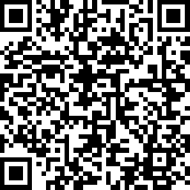
Adverse Childhood Experiences (ACEs)
Please use the link to fill out an evaluation. Thank you!
www.projectevers.org
Notes:
Ask your participants to complete the simple evaluation.

Slide 18
Adverse Childhood Experiences (ACEs)
Presenter name
Email
Phone
www.projectevers.org
Notes:
Thank you so much for your time and attention.
Please feel free to reach out with questions/comments.

