Slide 1
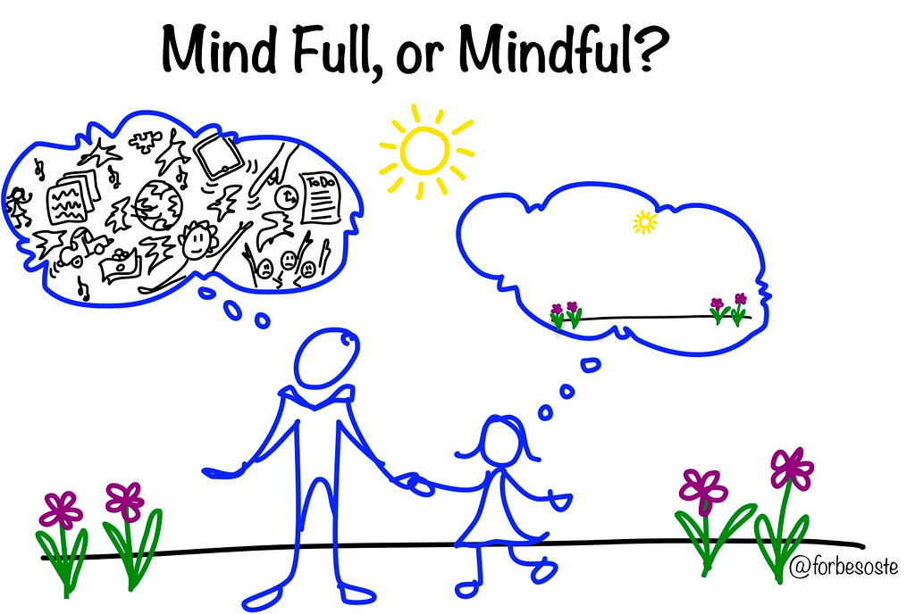
Project EVERS - Mindfulness
Mindfulness
Minute
Grounding Techniques for
Living in the Now
Presenter, title, organization
www.projectevers.org
Notes:
Students and educators alike will benefit from an understanding of the practice of mindfulness.
No matter the state of an individual’s mental health and wellness, mindfulness offers a specific way to calm and focus one’s mind in the moment.
This is immediately helpful whether dealing with an intense traumatic experience or simply small daily stresses.
The ability to teach students quick and relatively easy ways to counteract anxiety is a very important tool for each and every educator.

Slide 2
Mindfulness
Today you will learn:
The importance of practicing mindfulness in your own life before having the skills to impart it to others
To increase your ability to regulate emotions, decrease both stress and anxiety
Strategies to achieve personal wellness
www.projectevers.org
Notes:
Our objectives for today are:
Demonstrate an ability to practice mindfulness in your own life to develop the skills to communicate it to others.
Increase your ability to regulate emotions, decrease stress, and anxiety.
Teach a variety of strategies to achieve personal well-being.

Slide 3
Mindfulness
Mindfulness is:
The ability to intentionally focus on the present moment without judgment
Self-regulating our attention “with an attitude of curiosity, openness, and acceptance”
“Aliveness”
Not taking things for granted
Returning to the present moment
www.projectevers.org
Notes:
This module focuses on mindfulness—the ability to intentionally focus on the present moment without judgment.
The concept of mindfulness is about acting purposefully, rather than acting on auto-pilot.
It may mean something as simple as taking joy in little things like a loved one’s smile or the scent of a flower.
It includes the practice of slowing one’s breathing and becoming conscious of what is happening in the immediate surroundings.
Experts define mindfulness as the practice of self-regulating one’s attention “with an attitude of curiosity, openness, and acceptance,” to calm and soothe by shifting focus away from the effects of a stressor to the present moment. Trauma can be present in anyone’s life, but for many students and indirectly, their teachers, that stress can be multiplied in a number of areas ranging from family issues, cultural or language barriers, poverty, and poor physical or mental health .
Like any skill, mindfulness takes practice. It is important to encourage students with the reminder that often the only thing standing between us and our goals is a little bit of practice.
Mindfulness also includes the effort of not taking things for granted and returning one’s focus to the present moment again and again.

Slide 4
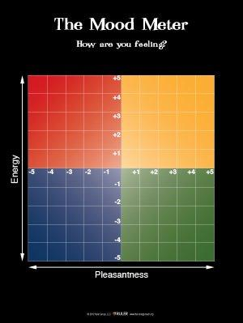
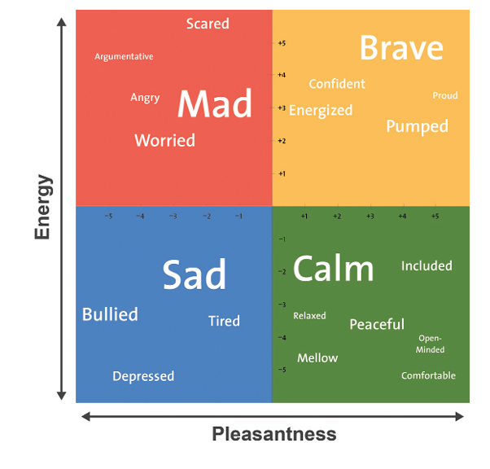
Mindfulness
ICEBREAKER-
Check in:
How are
you
feeling?
www.projectevers.org
Notes:
The question here isn’t “how are you doing” but how are you feeling, emotionally.
How many of you could readily identify your current emotional state and put it into words?
How many of you, if directly asked, would answer this question honestly versus respond with “good, fine, or busy”?
Why is it important for us to know where we’re at, emotionally? How do our emotions impact us?

Slide 5
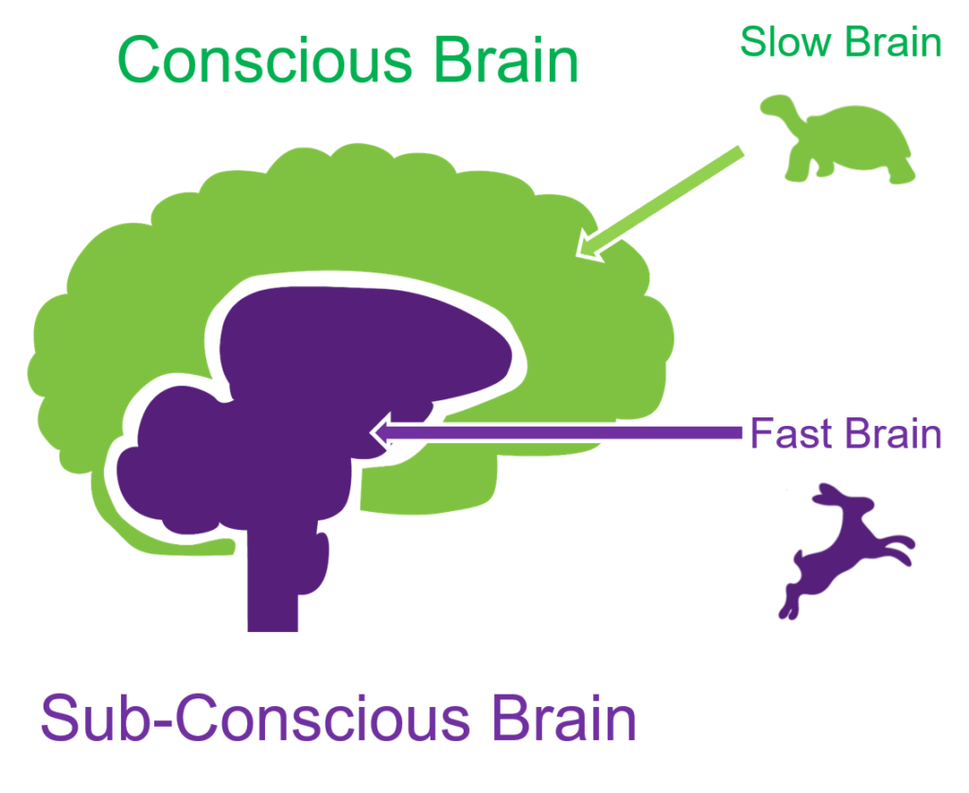
Mindfulness
www.projectevers.org
Notes:
Fast thinking is unconscious, emotional, instinctive. Fast thinking results in snap judgments and sometimes, prejudice, risky behaviors, or simply old bad habits.
Slow thinking is what most of us would consider actual thought. It is conscious, deliberative, and mostly rational.
We use both fast and slow thinking when we process information and make decisions, but we tend to avoid slow thinking when we can.
Slow thinking is more work for our brain and consumes more resources.
Fast thinking enables us to get through the day by handling routine decisions with minimum fuss.
When we make important decisions, both systems are usually engaged, though we may be mainly aware of our slow thinking.

Slide 6
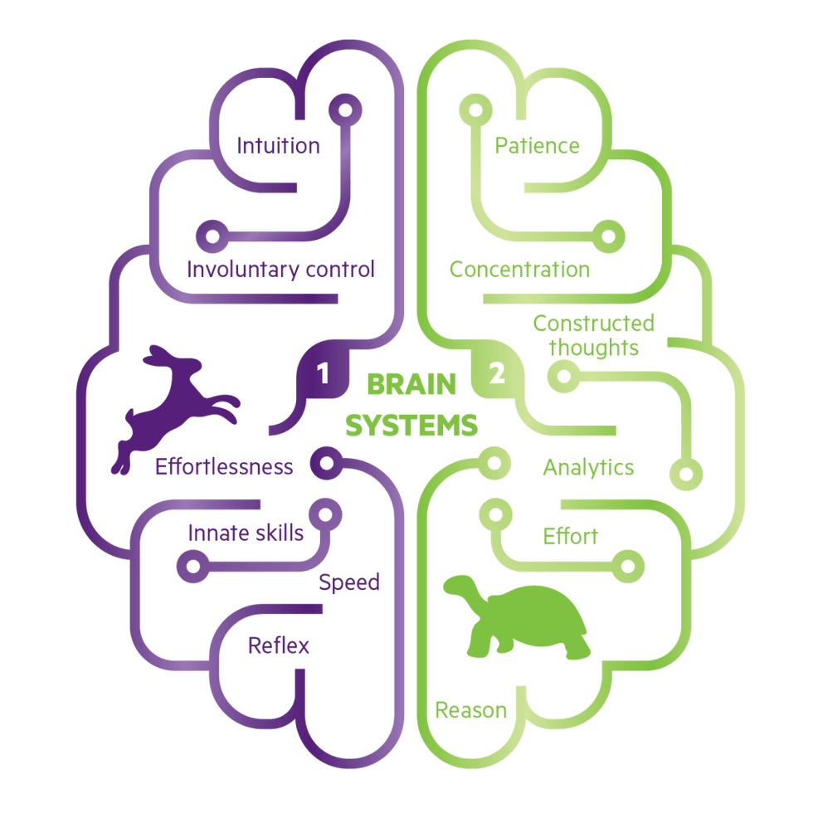
Mindfulness
Brain Systems
www.projectevers.org
Notes:
The left brain is known as System 1. It is the emotional, instinctual brain.
This is the brain that makes irrational decisions, such as buying an iPhone when you already have a functioning phone.
We all make System 1 decisions daily. System 1 decisions are the quick, everyday decisions.
The right brain is known as System 2. It involves rational, conscientious decision making.
This is the brain that makes logical decisions,
These decisions are slow, thought through well, analytical, and may be based on evidence and previous experience which is carefully considered.
The impulsive teen brain – age 14-25 - usually operates on a System 1 showing more impulsive, risky behaviors. And yes, you heard right, I did say 25. For the most part, the slow, analytical side of our brains are not fully developed until age 25, meaning the opportunity for risky behaviors remains in force until we learn to fully develop the rational thinking part of our brain.
Think about how much time do you use each side of your brain.

Slide 7
Mindfulness
Brain Systems
Notes:
Mindfulness is a strategy that can help us change those percentages to make better, healthier decisions more often.

Slide 8
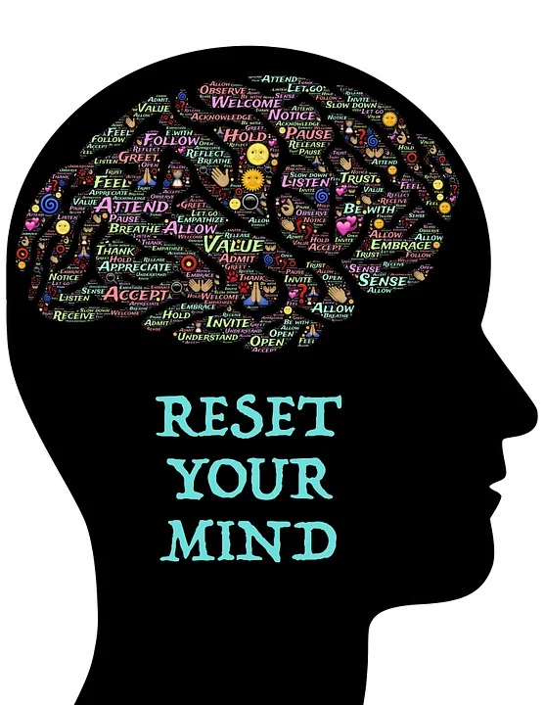
Mindfulness
Benefits of mindfulness:
Reduce stress
Increase focus
Improve emotion regulation
Increase empathy
Increase resilience
Improve physical well-being
Improved creativity and collaboration
www.projectevers.org
Notes:
Mindfulness strategies can help us all regulate our emotions and better deal with life’s stresses. They can help:
Reduce Stress: Improved ability to manage stress
Increase Focus: Improved ability to pay attention, focus and concentrate
Improve Emotion Regulation: Reduced impulsiveness, improved behavior
Increase Emotional Intelligence: Improved conflict resolution skills
Increase Empathy and Respect: Increased empathy and understanding of others
Increase Resilience: Increased capacity to overcome challenges
Improved Physical Well-being: Increased engagement in physical activity
Improved Creativity and Collaboration: Improved expression of creative arts

Slide 9
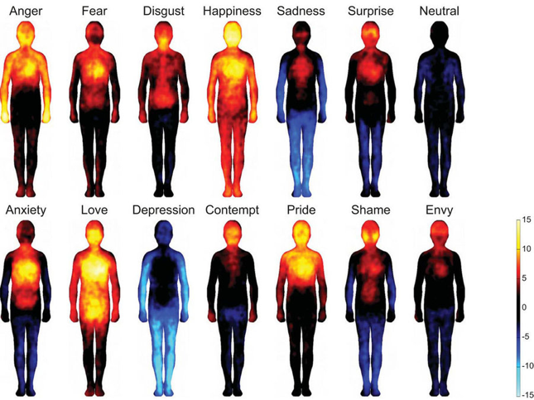
Mindfulness
ACTIVITY-
Check in:
Where are
you in your
body?
www.projectevers.org
Notes:
Take a moment and reflect on how your emotions may be evident in the way your body is feeling:
Does your body feel tight anywhere?
Is your heart beating fast or slow?
Does your body match up with what your mind is telling you?
What is your posture telling you about the way you’re feeling?
Think about how you can use this exercise with students.

Slide 10
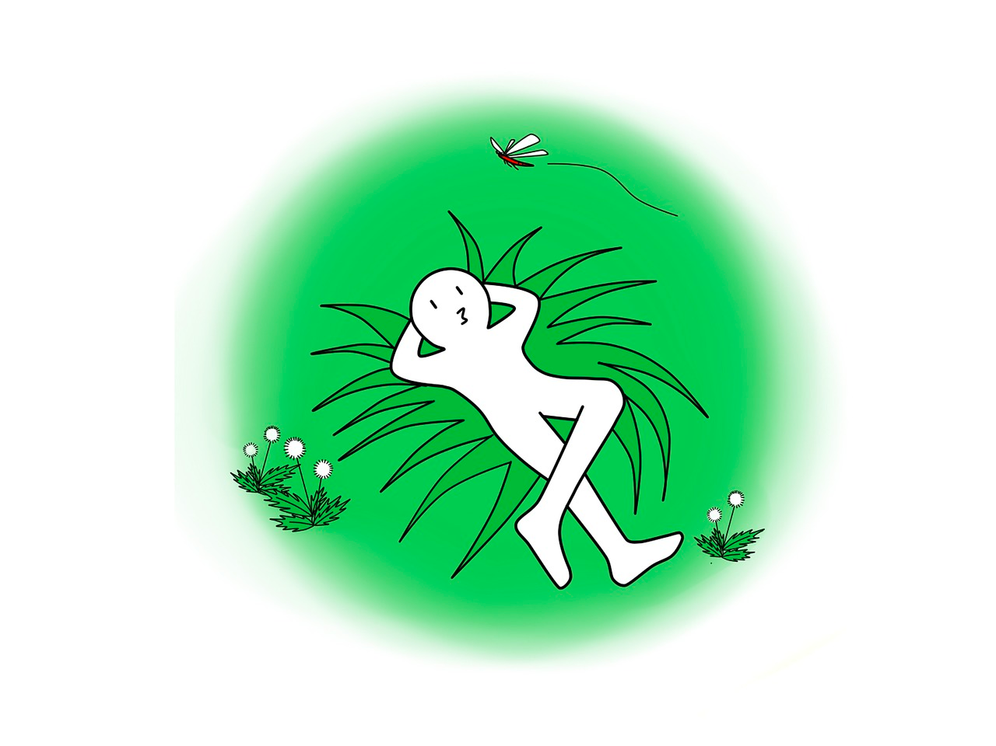
Mindfulness
Let’s Practice!
Body Scan Meditation
Walking Meditation
Petitation
www.projectevers.org
Notes:
Meditation: People who meditate are happier, healthier, and more successful than those who do not.
The amazing benefits of practicing meditation and mindfulness are available to everyone who takes time to practice these skills.
How many of you have pets? “Petitation” benefits not only you, but you and your pet. Everyone wins!

Slide 11
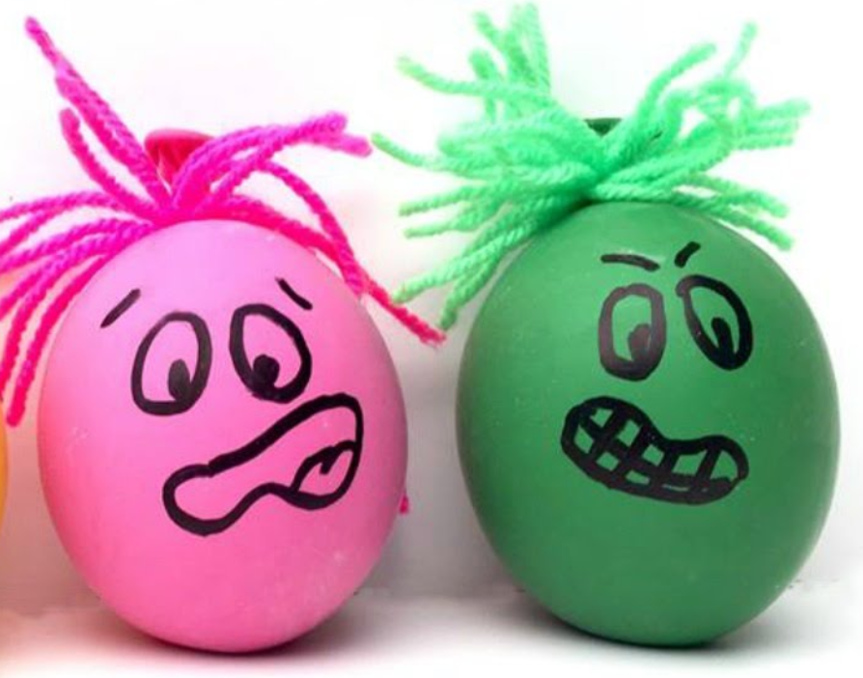
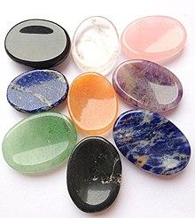
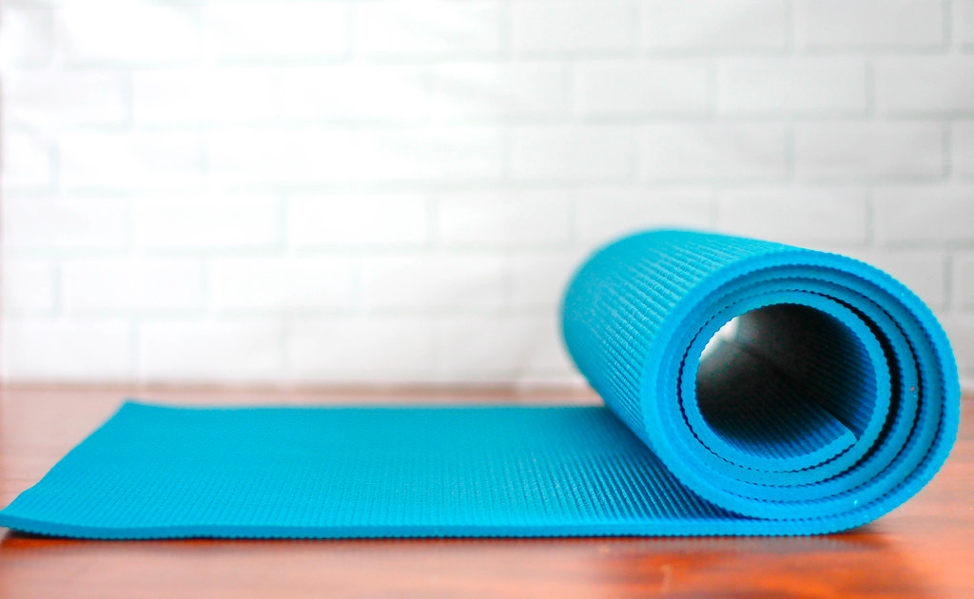
Mindfulness
Mindfulness Strategies and Tools:
Stress balls
LED votive candles
Worry stones
Quiet corner
Peace place (yoga mat)
Draw/color
Comfort kits
www.projectevers.org
Notes:
Mindfulness strategies offer additional ways for students to center themselves and prepare to engage in meaningful learning. Here are a few strategies and tools they can use to stay focused or refocus in a classroom/school setting.

Slide 12
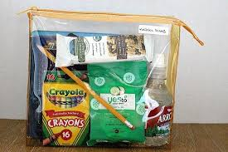
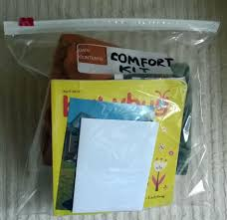
Mindfulness
Comfort Kits:
Can help reset/manage emotions.
Should be personalized.
Should be done in collaboration with the family if feasible.
Items may be bought at the dollar store or Amazon.
Ideally, assemble the kit with the students and practice how to use the items.
Place in an easily accessible/secure area.
www.projectevers.org
Notes:
Comfort kits are a collection of items that can bring comfort in times of stress and trauma. They can help normalize and bring the student back to the present and resilience zone.
When a student is in a stressful situation, having a few items readily available can help reset/manage emotions.
Items should be personalized to the student, since not all people relax the same way.
The collection of items should be done in collaboration with the family, since some items– like a favorite photo – can be one of the most effective items to include in their kit.
Ideally, assemble the kit with the student and practice how to use the items so they can use when needed.
Place the kit in an area that’s secure/accessible and that can be easily remembered.

Slide 13
Mindfulness
Comfort Kit Item Examples:
iPod or MP3 player with music for different moods
Family pictures
Snacks and candies/water
Essential oils or LED candles
Puzzle or craft project
Journal
www.projectevers.org
Notes:
There are no rules about what to include, but this is a list of suggestions.

Slide 14
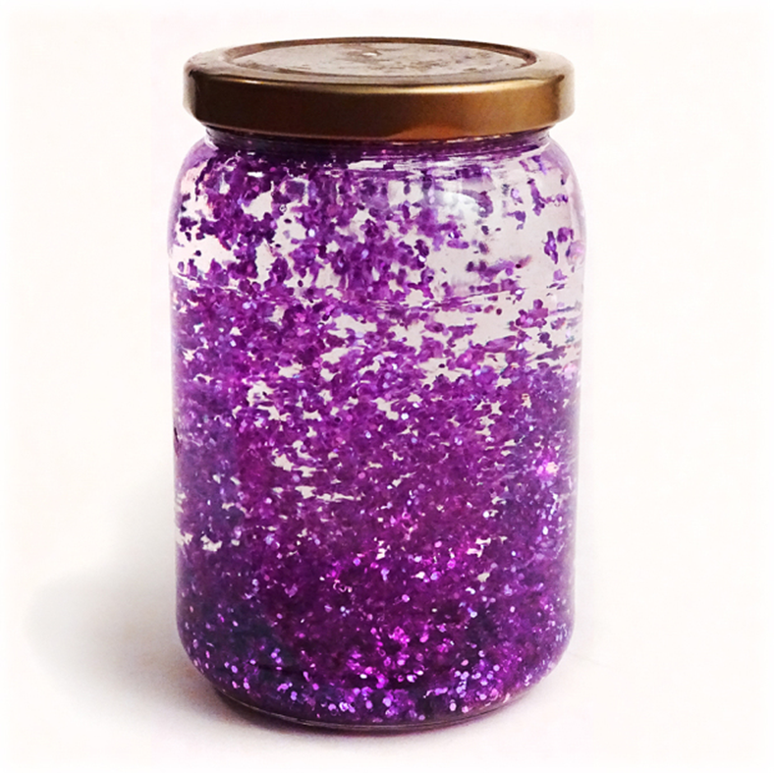
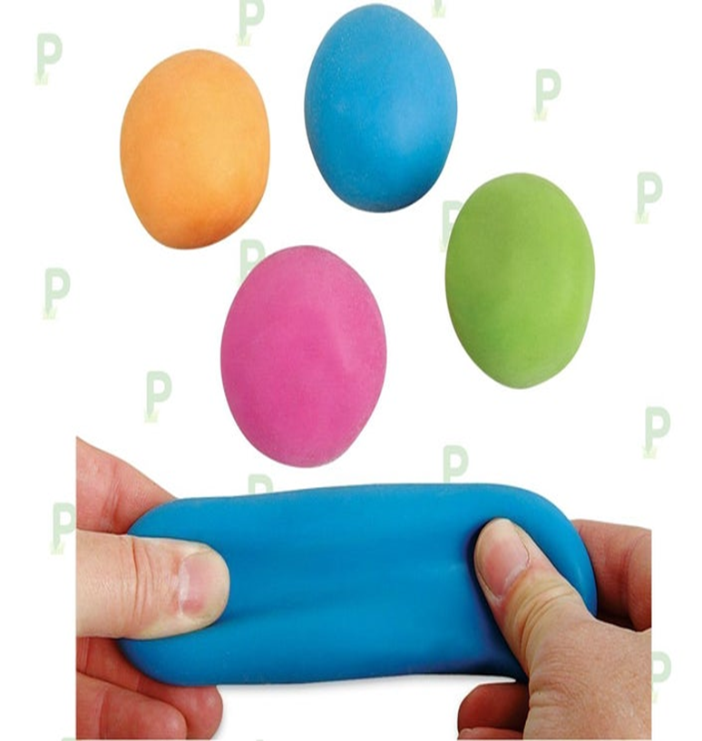
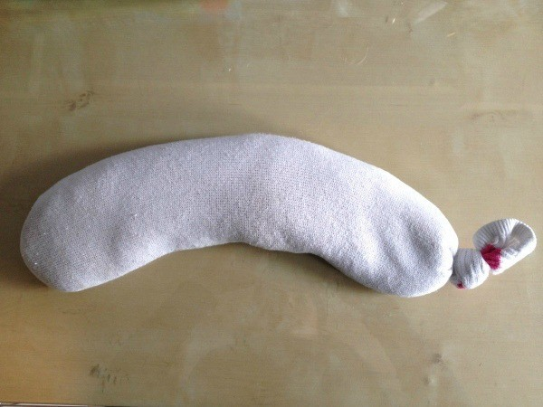
Mindfulness
More Items to Make with Students:
Gratitude list
Intention list
Mindfulness jar
Stress ball
Eye pillow
www.projectevers.org
Notes:
There are several items that can be made with students that will encourage mindfulness:
A gratitude list can be powerful and won’t cost any money.
There are several ways to make Mindfulness Jars (also known as glitter or calm down jars).
Squishy stress balls are quick and easy to make and highly effective for keeping hands and minds busy.
Eye pillows are comforting and calming.

Slide 15
Mindfulness
ACTIVITY-
Intention Setting
www.projectevers.org
Notes:
Objectives:
• Recognize the importance of developing intentions about how you want to be, live, and show up in the world.
• Understand the importance of the gifts you have available, identify those you wish to cultivate and those you recognize in others.
• Develop a list to remind you of all that you have to share when working with others.
Steps:
• Guide the participants in a discussion:
o What matters most to you? Your answers could form a powerful intention(s) for which you can align your thoughts, not only for meditation, but also to guide your actions as you move through your day.
An intention is not a goal, it is just something you want to align with in your life. It is an aim, a purpose, or attitude to which you would be proud to commit.
o Intentions evoke feelings and purpose. Setting an intention is a way to bring your feelings and thoughts into alignment. Try to keep the intention brief and positive (i.e.”begin spending time with others” instead of “stop
being isolated and lonely”).
• Have participants create a list of ideas for setting intentions.
o Use the following questions to prompt their thinking:
What matters most to you?
What would you like to build, create, or nurture in your life?
What would you like to let go of?
Who would you like to forgive in your life?
How do you feel when you are your happiest self?
What makes you proud?
What word(s) would you like to align yourself with?
What fears would you like to release?
What are you grateful for?

Slide 16
Mindfulness
ACTIVITY-
Five Senses Mindfulness Exercise
www.projectevers.org
Notes:
Objective:
• Provide guidelines to practice mindfulness quickly in any situation. The goal is simply to pay attention to what one is experiencing with each of the five senses.
Steps:
Guide participants:
1. Notice five things you can see. Look around you and bring your attention to five things that you can see. Pick something that you do not normally notice, like a shadow or a small crack in the concrete.
2. Notice four things that you can feel. Bring awareness to four things that you are currently feeling, like the texture of your pants, the feeling of the breeze on your skin, or the smooth surface of a table on which your hands are resting.
3. Notice three things that you can hear. Take a moment to listen and note three things that you hear in the background. This can be the chirp of a bird, the hum of the refrigerator, or the faint sounds of traffic from a nearby road.
4. Notice two things you can smell. Bring your awareness to smells that you usually filter out, whether they are pleasant or unpleasant. Perhaps the breeze is carrying a whiff of pine trees if you are outside, or the smell of a fast-food restaurant across the street.
5. Notice one thing you can taste. Focus on one thing that you can taste at this moment. You can take a sip of a drink, chew a piece of gum, eat something, notice the current taste in your mouth, or even open your mouth to search the air for a taste.

Slide 17
Mindfulness
ACTIVITY-
Yoga
Classroom
Activity
www.projectevers.org
Notes:
Objectives:
• Introduce yoga as an activity to practice mindfulness and enable students to improve symptoms of stress and anxiety.
• Learn five easy ways to focus on the five senses and breathing:
o mountain pose
o downward facing dog
o tree pose
o bridge pose
o extended child’s pose
Materials:
• Yoga 4 Classrooms cards (retail price $32).
http://www.yoga4classrooms.com/activity-card-deck
Yoga 4 Classrooms (Y4C) helps students develop the self-awareness to realize how they feel and what they need; teaches them strategies to slow down, unwind and manage their emotions;
guides them through movements that optimize their strength, flexibility and balance; demonstrates healthy habits; and reminds them to love and forgive themselves. Y4C provides
students with tools for learning and lessons for life.
• Larger 6 x 8 boxed set features 67 yoga poses, brain boosting movements, breathing exercises, visualizations, mindfulness activities, creative movement and community building games. Wellness and character-building discussion points such as the power of positive thinking, nutrition, and being a peacemaker, address the whole child – physical, social and emotional are included.

Slide 18
Mindfulness
ACTIVITY-
Making
Stress
Balls
www.projectevers.org
Notes:
Objective:
• Students will understand the benefits of stress balls for keeping hands and minds.
busy.
Materials:
• Three balloons
• Rice or flour
• Funnel
• Scissors
Steps:
• Stretch out the balloon. (Tip: simply blow it up for some extra stretch.)
• Choose the filling of rice or flour.
• Stick a funnel into the neck of the balloon.
• Pour slowly to avoid clogging the neck of the balloon; if it does clog, use a pen or
pencil to clear the opening.
• Remove the funnel from the balloon and let out as much air as you can. (Tip: to release the air, pinch near the neck and separate your finger and thumb slightly; too wide an opening can blow flour everywhere.)
• Tie the neck of the balloon closed tightly.
• Snip off the excess rubber.
• Grab the second balloon and snip off the end.
• Grab the last balloon, and snip the end, leaving enough to tie.
• Tie the end, and you’ve made yourself a squishy stress ball.
NOTE:
The website https://patch.com/us/dealtown/buy-or-diy-how-make-squishy-stress-ball provides several ideas to make personalized stress balls.

Slide 19
Mindfulness
ACTIVITY-
Making
Eye
Pillows
www.projectevers.org
Notes:
Objective:
• Create ways to calm the senses before sleep.
Materials:
• Inexpensive knee socks
• Rice and flax seed
• Essential oil(s)
• Funnel
• Scissors
Steps:
• Purchase or locate inexpensive knee socks. Wash to create softness and tie a knot in the bottom.
• Mix the rice and flax seed (any ratio/consistency will work). Flax seed is not necessary but does create more softness for the pillow. Toss the ingredients into a bowl, and let the participants mix it up with their hands talking about the senses, how it feels, how it smells, and what it looks like.
• Add the essential oil, remembering a few drops goes a long way (three or four drops are plenty). If you have different oils, have the participants smell the bottles and choose which they like best. Mix again after adding the oils.
• Insert funnel in the sock and gently pour the rice mixture into the sock.
• Tie a knot at the end of the sock.
• Have participants try out the mask and discuss how it makes them feel more relaxed.
NOTE:
With simple ingredients like socks, rice, funnels and essential oils (optional), these eye pillows can be created quickly and easily. For detailed instructions, check out the website http://www.lazylizardsyoga.com/kids-yoga/creative-crafty-and-calming/.

Slide 20
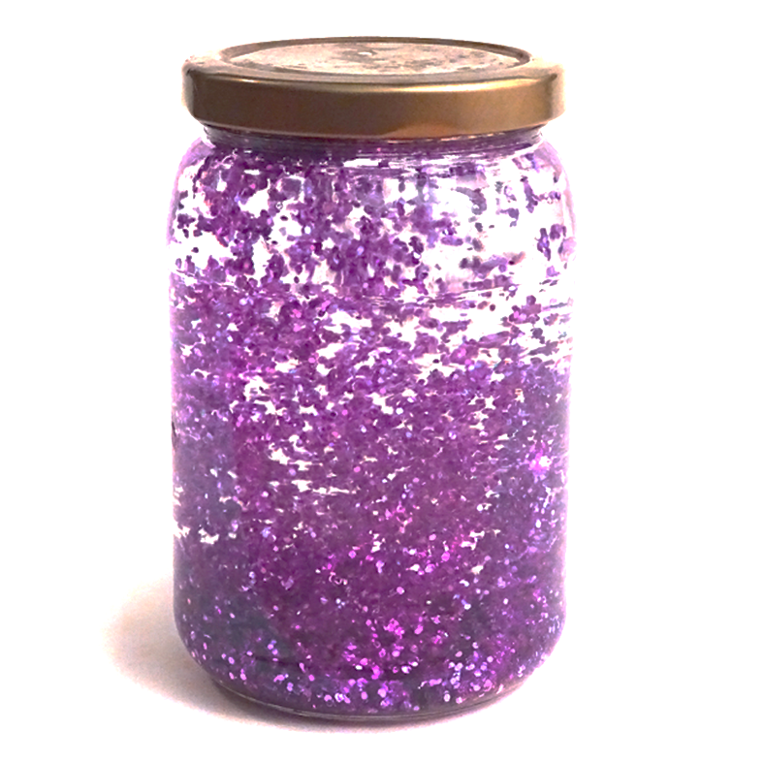
Mindfulness
ACTIVITY-
Making Mindfulness
Jars
www.projectevers.org
Notes:
Objectives:
• Involve the participants in something that will facilitate mindfulness and relaxation.
• Coach participants in ways to soothe themselves, calm down, and work through emotions.
• Provide something tangible for participants that they can keep in their living or classroom space.
Materials:
• Clean plastic bottles
• Hot water
• Mixing bowl (preferably one with a pouring spout to easily put it in the
mindfulness jar)
• Whisk
• Liquid watercolor or food coloring
• Fine glitter
• Elmer’s Washable Clear Glue
Steps:
1. Pour glue and hot water into the mixing bowl, along with some liquid watercolor or food coloring, and glitter.
2. Mix with the whisk. When everything is blended, continue mixing vigorously as you immediately pour into the water bottle. This helps the glitter transfer to the water bottle instead of settling in the mixing bowl.
NOTES:
• The preschool inspiration site https://preschoolinspirations.com/6-ways-to-make-a-calm-down-jar/ provides instructions for making the mindfulness jars six different ways. Ingredients include plastic jars, glitter, glue, water and /or corn syrup. To make your own, take a look at the site and select a recipe or use the one above.
• This video https://www.youtube.com/watch?v=sT2WjQxuEnE also provides step-by-step instructions.
• Use this activity one-on-one or in a small group. You will need warm water, which may not be suitable to a large group training. Cover the area to contain messes.
• Materials may be found at arts and craft stores or through Amazon (they have large jars of clear glue). Voss water bottles work best and may be cheaper than mason jars.

Slide 21
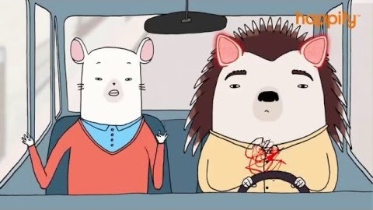
Mindfulness
Mindfulness as a Superpower
www.projectevers.org
Notes:
Let's conclude with this short video. Mindfulness truly is a superpower and an important tool for ourselves and the students we serve.
https://www.youtube.com/watch?time_continue=28&v=w6T02g5hnT4&feature=emb_logo

Slide 22
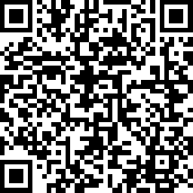
Mindfulness
Please use the link to fill out an evaluation. Thank you!
www.projectevers.org
Notes:
Ask your participants to complete the simple evaluation.

Slide 23
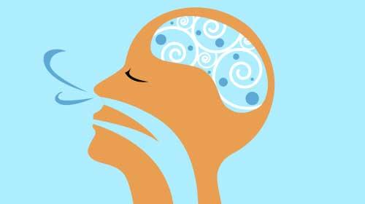
Mindfulness
Presenter name
Email
Phone
www.projectevers.org
Notes:
Thank you so much for your time and attention.
Please feel free to reach out with questions/comments.

