Slide 1
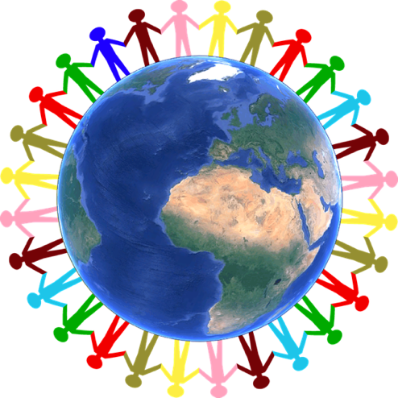
Project EVERS
Cultural
Responsiveness
Presenter, title, organization
www.projectevers.org
Notes:
According to the National Center for Culturally Responsive Educational Systems (NCCREST), “cultural responsiveness is the ability to learn from and relate respectfully with people of your own culture as well as those from other cultures.”

Slide 2
Cultural Responsiveness
Today you will learn to:
Understand your own cultural lens and explore different types of cultural diversity.
Identify some barriers to addressing mental health in different communities.
Develop culturally responsive practices (awareness and competence).
www.projectevers.org
Notes:
The objectives for today’s session are:
· Understand educator’s own cultural lens and explore different types of cultural diversity.
· Identify some barriers to addressing mental health in different communities.
· Develop culturally responsive practices (awareness and competence).

Slide 3
Cultural Responsiveness
There is no:
“Right way” to manage cultural awareness, sensitivity, or responsiveness
Single correct answer
Detailed list of dos and don’ts.
www.projectevers.org
Notes:
Culture:
· Shapes our cognition, behavior, language, and how we educate.
· It affects how we teach, what we teach, and why we teach it. These things can vary from culture to culture.
· The components of culture are not static – they are always changing.
We are always learning about different cultures in our profession. This slide is a good example to remind ourselves that there is not a “right” or “wrong” way to understand someone’s culture – cultures are fluid.

Slide 4
Cultural Responsiveness
Cultural stereotypes and biases (based on race, ethnicity, sexual orientation, age, religion, gender-identity, geography, etc.) exist and influence all of us,
often unconsciously.
www.projectevers.org
Notes:
These are some ways you can learn from people from other cultures:
Make a conscious decision to establish friendships with people from other cultures.
Put yourself in situations where you will meet people of other cultures. (Especially if you haven’t had the experience of being a minority.)
Examine your biases about people from other cultures.
Ask people questions about their cultures, customs, and views.
Read about other people's cultures and histories.
Listen to people tell their stories.
Notice differences in communication styles and values; don't assume that the majority's way is the right way.
Risk making mistakes.
Learn to be an ally.

Slide 5
Cultural Responsiveness
ACTIVITY: ICEBREAKER Greetings Around the World
Objective:
Highlight how culture adds layers of complexity in order to demonstrate stigma surrounding mental health in different cultures.
www.projectevers.org
Notes:
Highlight how culture adds layers of complexity in order to demonstrate stigma surrounding mental health in different cultures.
Steps:
1. Cut the Greetings Around the World Worksheet into separate strips of paper with the individual greetings and distribute one to each participant.
2. Ask them to read it and keep it to themselves.
3. Once people have read it, tell them they will be greeting each other according to the instructions on the piece of paper they received.
4. Participants are not allowed to say anything (including the country from which the greeting comes), except what is specifically on the piece of paper.
5. Provide an example with the English-language way of greeting (formally):
“Hi, how are you?”
Shake hands. (Note: This practice may change in a post-COVID-19 world.)
6. Ask participants to get up and greet each other according to their strip of paper.
7. Discuss:
What happened?
How did you feel?
How is this related to working with students from different cultures?
Can you see how these differences could be related to cultural stigma and misconceptions about mental health?

Slide 6
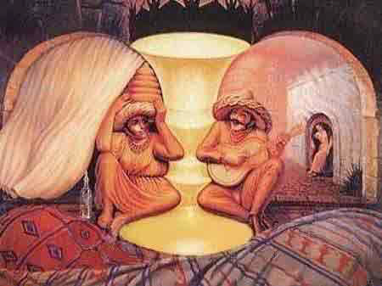
Cultural Responsiveness
ACTIVITY: What Do You See?
This activity uses images that can be perceived in different ways. What do you see? Can you see it another way? Even when you are able to recognize two images, does one image dominate your perception?
www.projectevers.org
Notes:
Objectives:
• Highlight how two or more people can experience the same event or situation yet walk away from it having distinctly different perceptions and impressions about it.
• Understand that we all view the world around us through a lens that has been shaped by our individual experiences.
Steps:
1. Display the image(s).
2. Discuss how the activity uses images that can be perceived in different ways:
What do you see?
Can you see it another way?
Even when you are able to recognize two images, does one image dominate your perception?

Slide 7
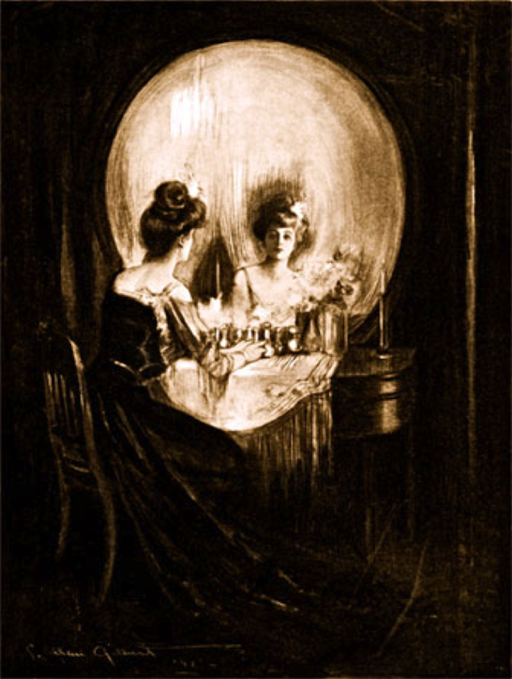
Cultural Responsiveness
www.projectevers.org
Notes:
Continue Activity 3.2

Slide 8
Cultural Responsiveness
ACTIVITY: How I See It
In this activity, there are nine instances of behavior to which you have to write your immediate response. For example, “At the end of a meal, people belch audibly.” Your interpretation of that action might be: “That is rude and disgusting and poor manners.”
www.projectevers.org
Notes:
Objectives:
• Highlight that everyone believes reality is real—things are the way they are—but the truth is that one person’s perception of an event or idea might not be the same as someone else’s perception of that same event or idea. Two people can look at the same thing, like the same example of behavior, and see two entirely different things.
• Understand that some students come from a different culture and have different life experiences than the staff member working with them. This activity helps participants recognize that any behavior has at least two interpretations. First, what the person doing the action thinks they are expressing; and second, the meaning that a person who observes the action gives to it.
• Participants will be able to articulate how their personal cultural perspectives affect their interpretations of situations they encounter.
Steps:
1. Distribute one How I See It worksheet per participant.
2. Read the first behavior out loud to the group and have participants write their immediate first response to or interpretation of the behavior.
3. Continue to read the behaviors out loud and have participants write their individual responses to each behavior or have them complete their responses on their own.
4. If time allows, have participants share their responses so all can see the variations in responses.

Slide 9
Cultural Responsiveness
ACTIVITY: Exploring Stigma
Why is it important to fight stigma?
How is mental health seen in your culture and the culture of the families/students with whom we work?
What can we do locally and statewide to promote awareness?
www.projectevers.org
Notes:
Objective:
• The participant will examine their own and their culture’s view of mental health.
Steps:
1. Pass out a copy of the Breaking the Stigma document to each participant.
2. Explain that stigma is present in all cultures and how it can hurt.
3. Ask participants, “What is the first thing that comes to mind when you hear ‘mental health’?”
4. Have participants look at the Breaking the Stigma document individually.
5. Have participants discuss in groups:
Why is it important to fight stigma?
How is mental health seen in your culture and the culture of the families/students with whom we work?
What can we do locally and statewide to promote awareness?
6. Participants will write their answers on chart paper.
7. Facilitator can have a brief discussion by tables or have the participants do a gallery walk and add their thoughts on sticky notes.

Slide 10
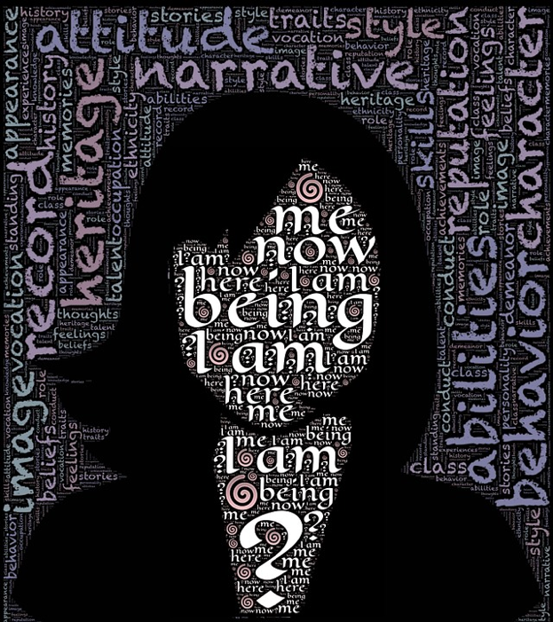
Cultural Responsiveness
ACTIVITY: Self-Identity Intersections
Reflect on what self-identity and culture intersections with which you can identify.
Examples are religion, nationality, race, sexual identity, age, etc.
For instance: Puerto Rican, Latina, Midwesterner, wife, dog-mom, educator
www.projectevers.org
Notes:
Objective:
• Participants will explore their own cultural identity in order to understand the complexity of culture.
Steps:
1. Reflect on what self-identity and culture intersections with which you can identify:
Examples are religion, nationality, race, sexual identity, age, etc.
For instance: Puerto Rican, Latina, Midwesterner, wife, dog-mom, educator.
2. Ask participants to think:
How does this connect to your work with students?
3. Ask participants to list or describe identities they identify with in their daily lives.
4. Have partners share thoughts together.
5. Discuss as a group:
What is the connection to the different students’ cultures?

Slide 11
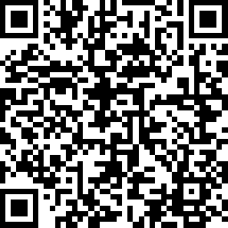
Cultural Responsiveness
Please use the link to fill out an evaluation. Thank you!
www.projectevers.org
Notes:
Ask your participants to complete the simple evaluation.

Slide 12
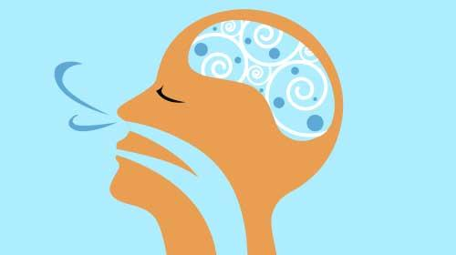
Cultural Responsiveness
Lora Thomas
lthomas@nkesc
(217) 416-6111
www.projectevers.org
Notes:
Thank you so much for your time and attention.
Please feel free to reach out with questions/comments.

